Slide 1


Summary of the pupils` discussion
“Advantages and disadvantages of team and individual sports”
Improving Standards in Teaching School Sport to Foster Physical, Cognitive and Social Development in Pupils
Madona Secondary School No.1
January 23-27, 2017
Madona, Latvia

Slide 2
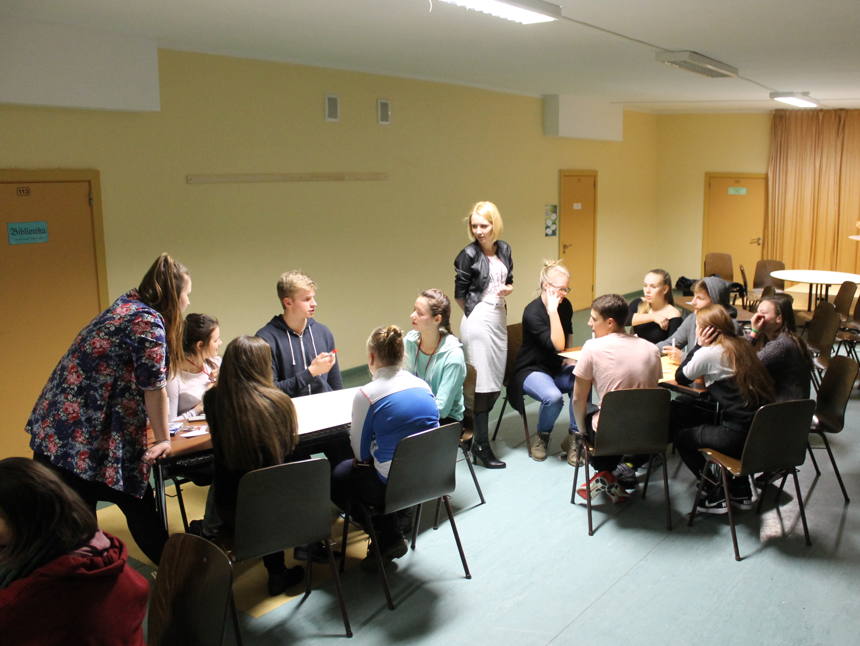

Slide 3
Team sport is a team work when you win and lose together.
Pluses
+ Your teammates may become your friends and you have friends/teammates to train with;
+ You can get energy, motivation, help, moral and emotional support from teammates;
+ There is someone who could help you when it`s not your lucky day;
+ You have to learm communication;
+ It`s great fun to be together.

Slide 4
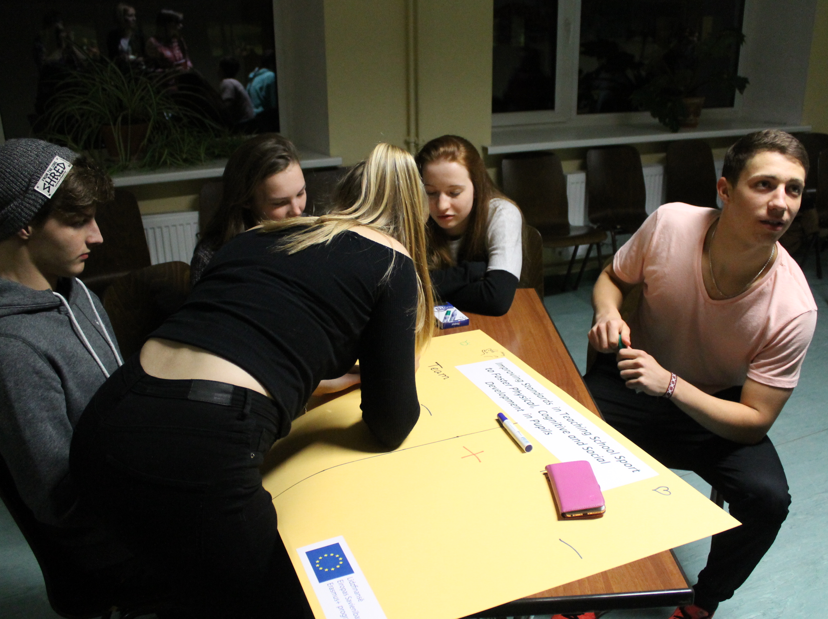

Slide 5
Team sport is a team work when you win and lose together.
Minuses
- It`s hard to find a space to improve yourself;
- Some people can bring down the team;
- It`s possible to have arguments with other teammates or to be in the same team with people you don`t like.

Slide 6
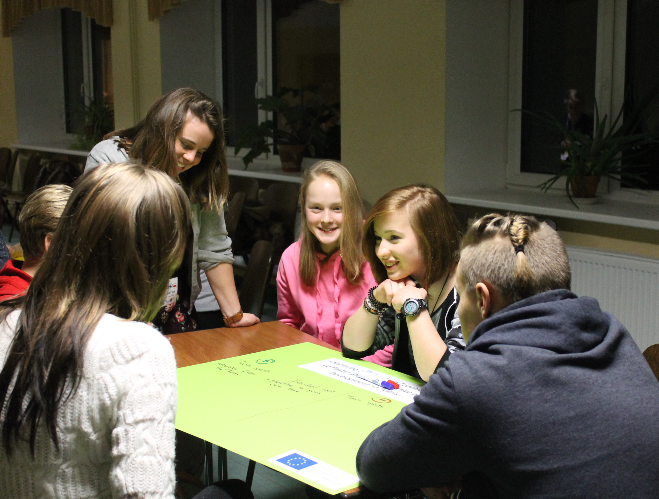

Slide 7
Individual sport is your own work but if you win the prize is only yours.
Pluses
+ You are independent and can practise in your own time;
+ You are not angry with others and nobody can blame you;
+ Your results are up to you.

Slide 8
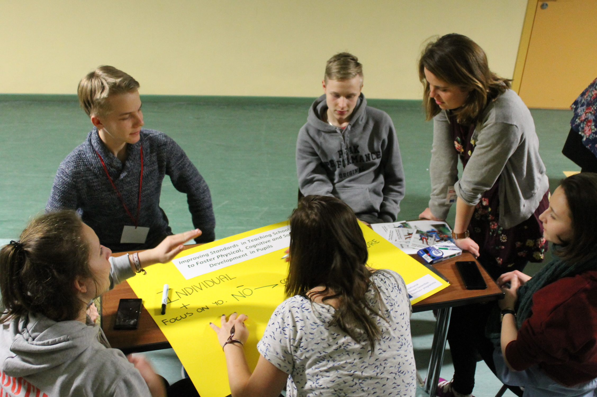

Slide 9
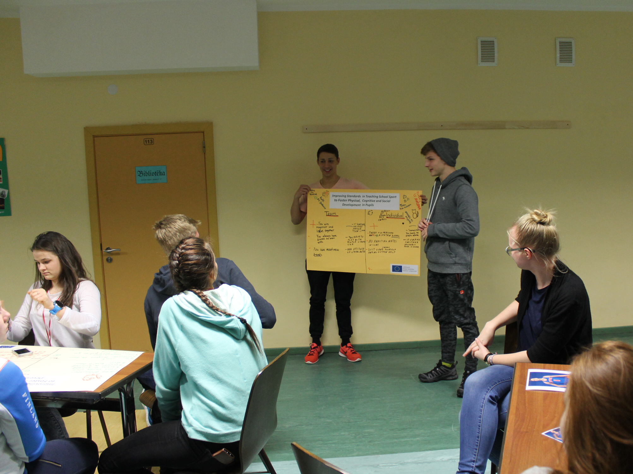

Slide 10
Individual sport is your own work but if you win the prize is only yours.
Minuses
- You are alone, sometimes you feel lonely;
- You don`t have any support.

Slide 11
