Slide 1

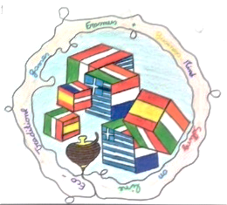







TRADITIONAL GAMES FROM AROUND THE WORLD
JUNIOR BUSINESS MINDS SELLING ONLINE ECO-TRADITIONAL GAMES

Slide 2
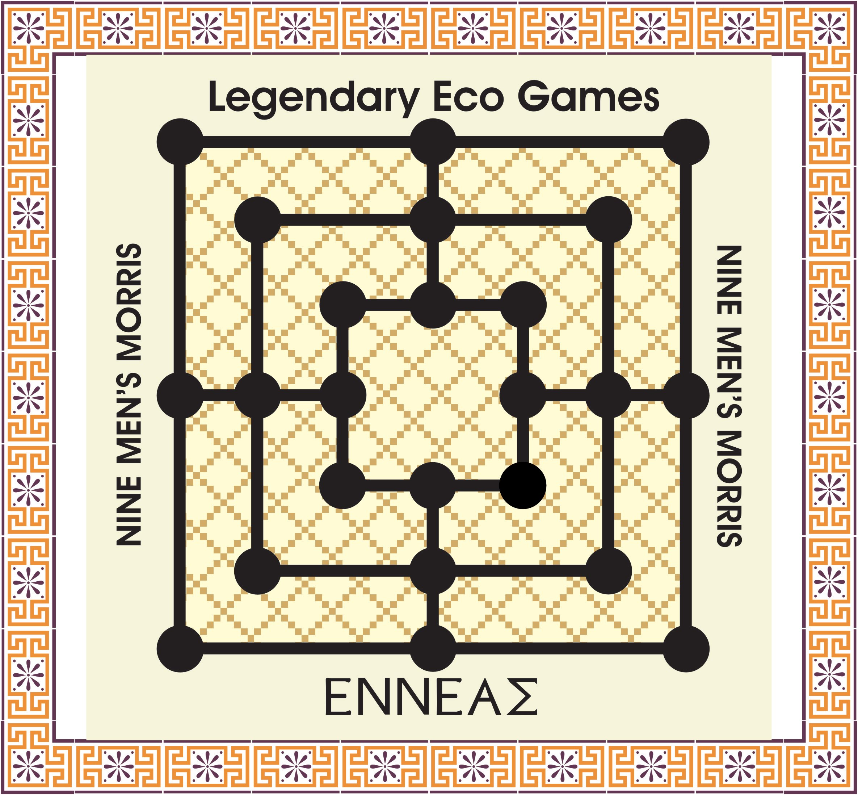
ΕΝΝΕΑΣ - ENNEAS
Game from Greece
Legendary Eco Games
Nine Men's Morris

Slide 3
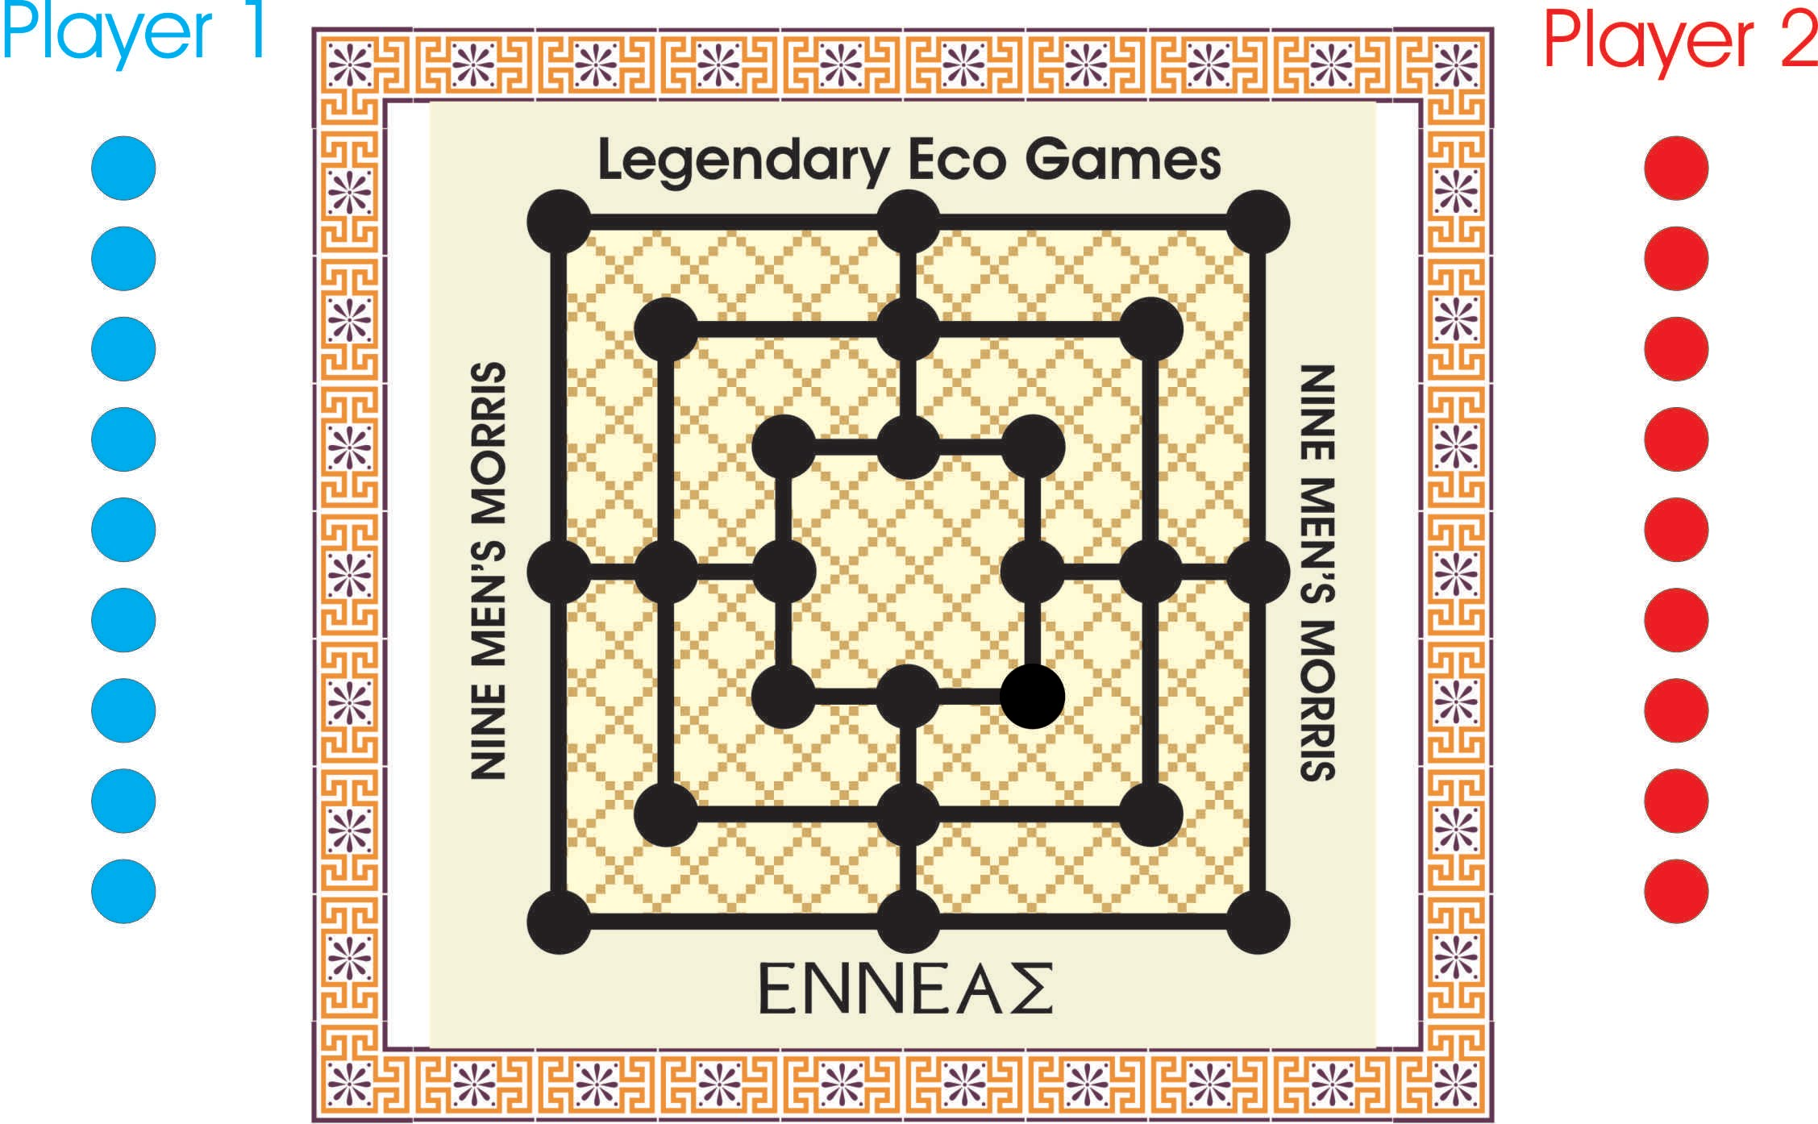
EQUIPMENT
Game Board
Nine pieces for each player

Slide 4
GOAL OF THE GAME
The goal of the game is to make “mills” :
vertical or horizontal lines of three pieces.
Every time a mill is formed the player can remove an opponent's man from the game.
A player wins by reducing the opponent to two pieces.

Slide 5
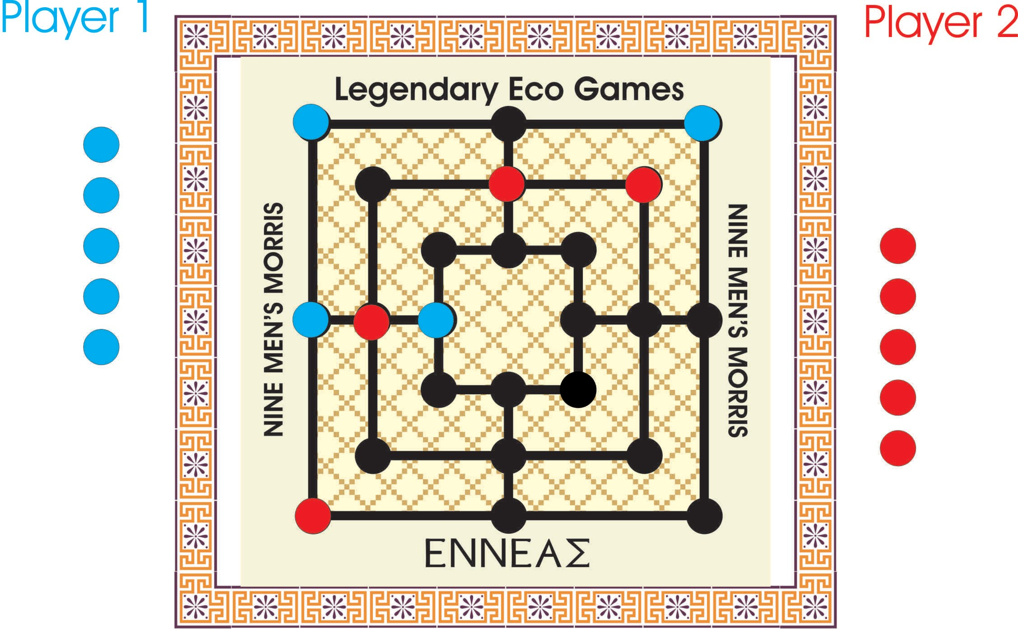
Phase 1 - Placing men to vacant points

Slide 6
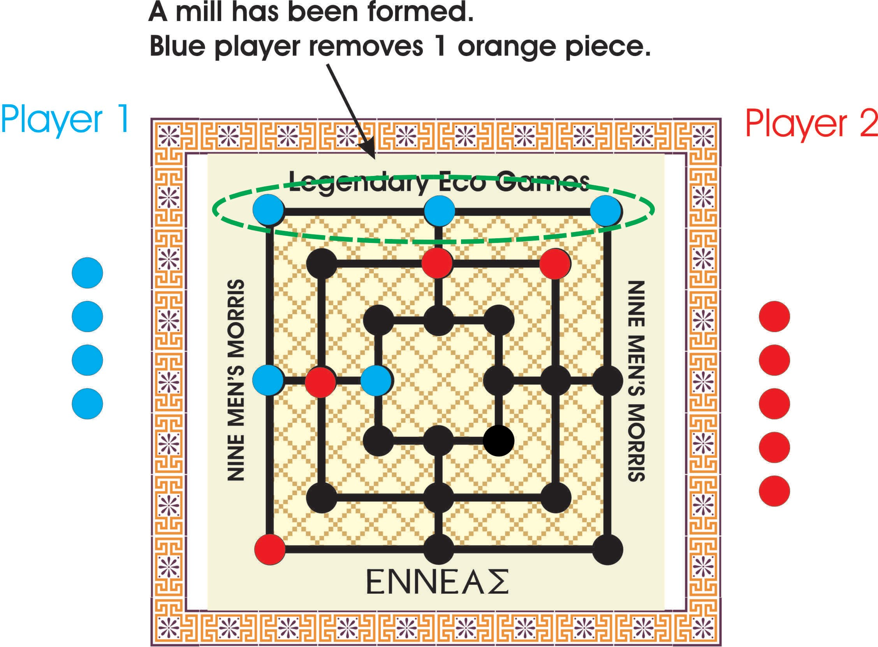
During phase 1 a mill has been formed.

Slide 7
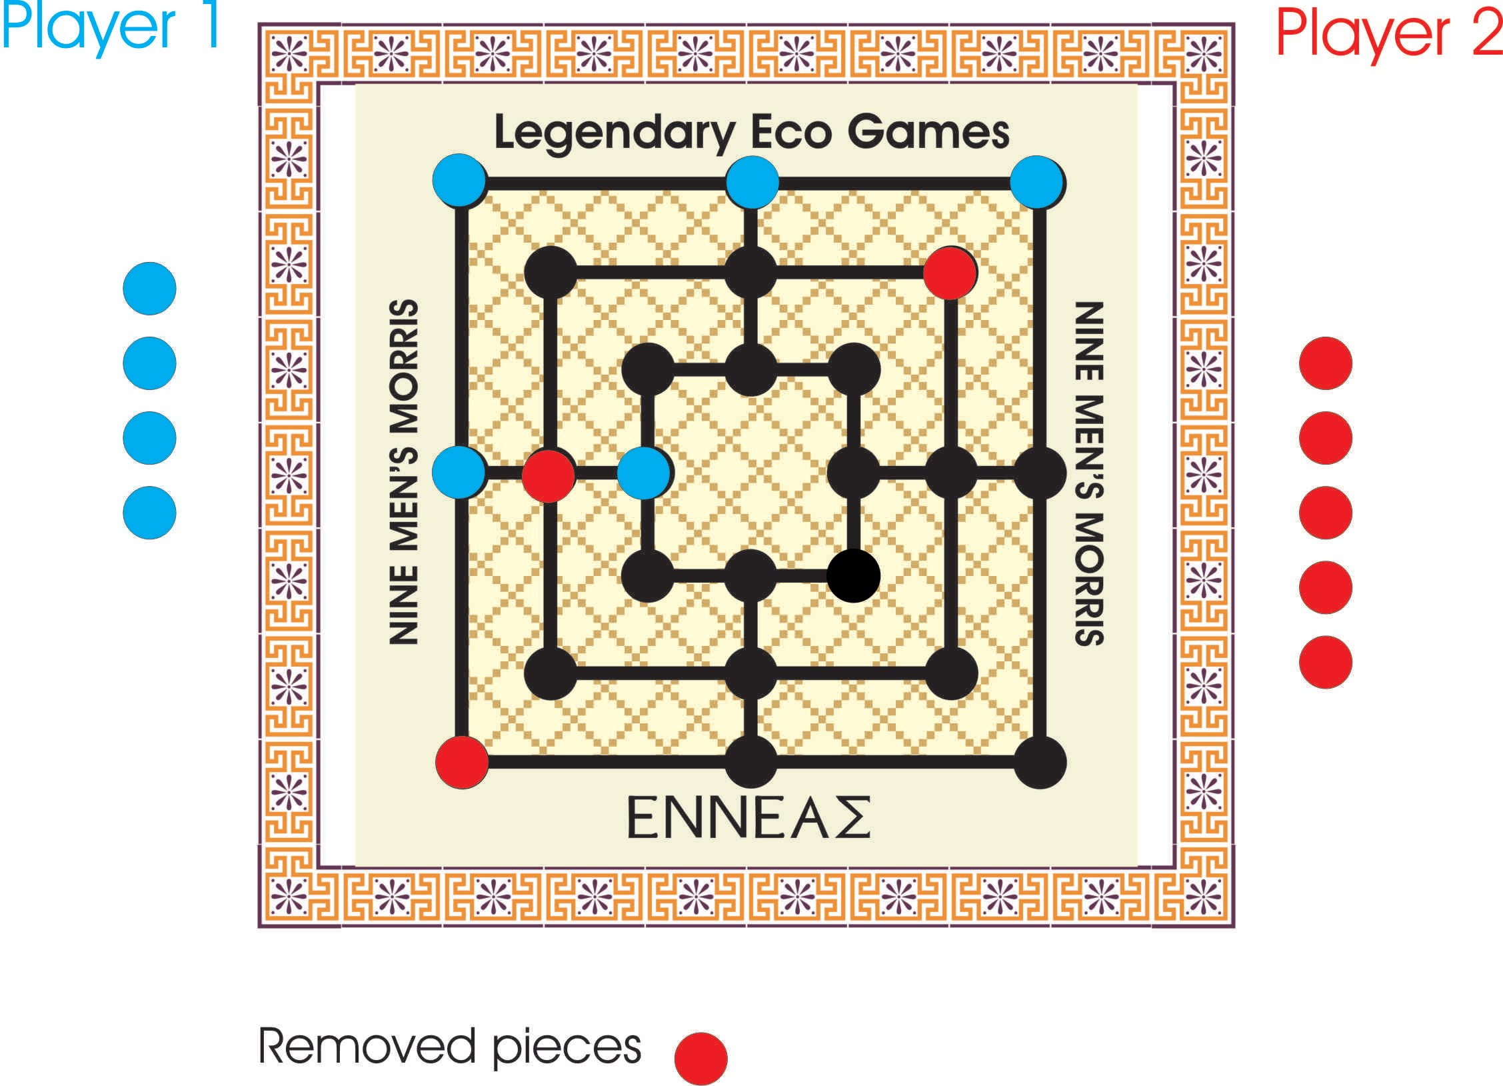
The removed piece remains out of the game.

Slide 8
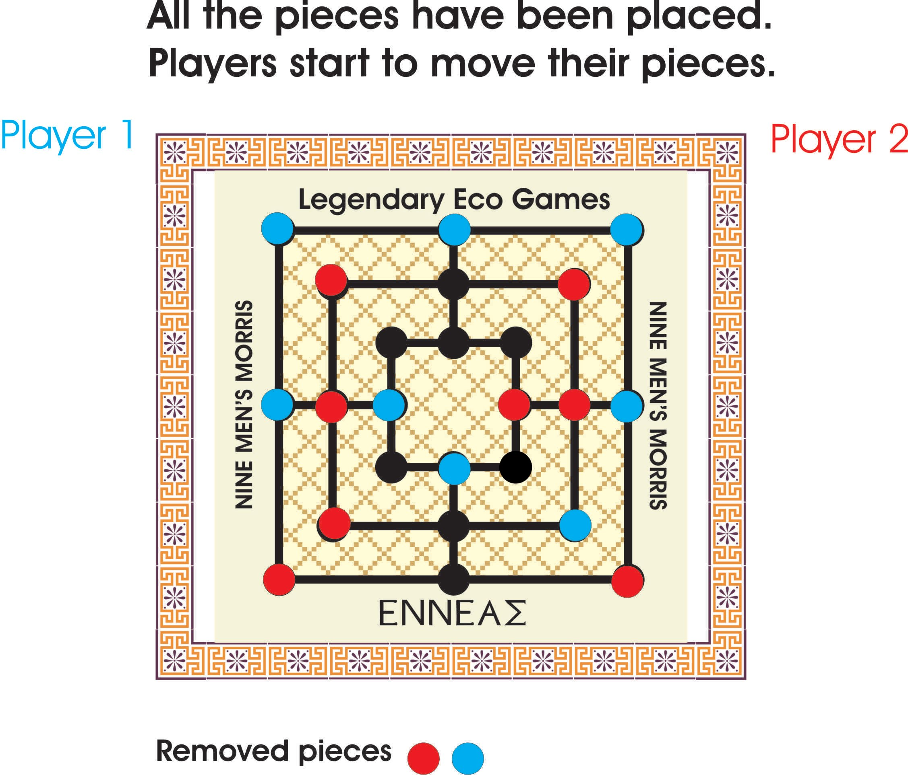
Phase 2 - Moving men to adjacent points.

Slide 9
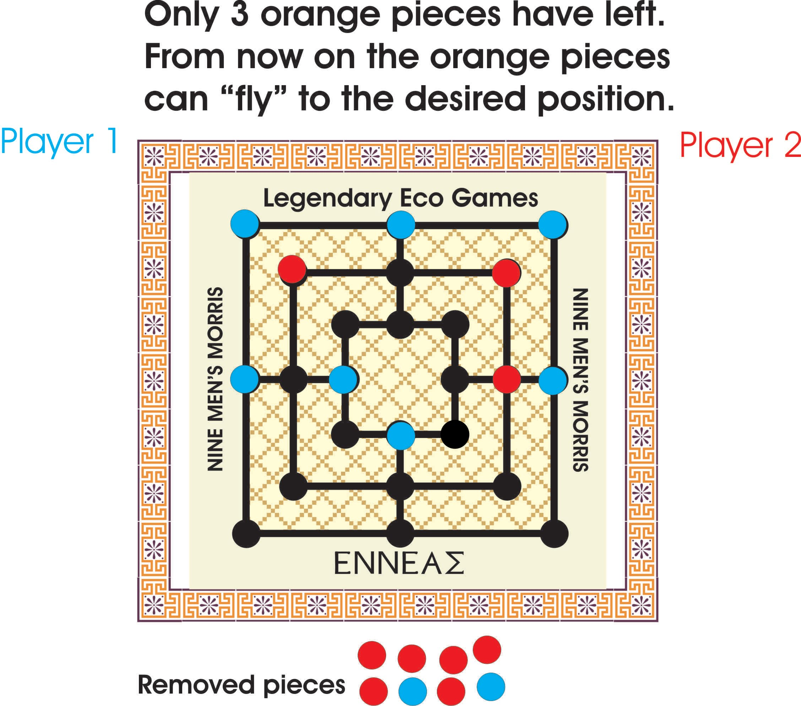
Flying
A player is reduced to 3 pieces.
The player's men can move to any vacant point.

Slide 10
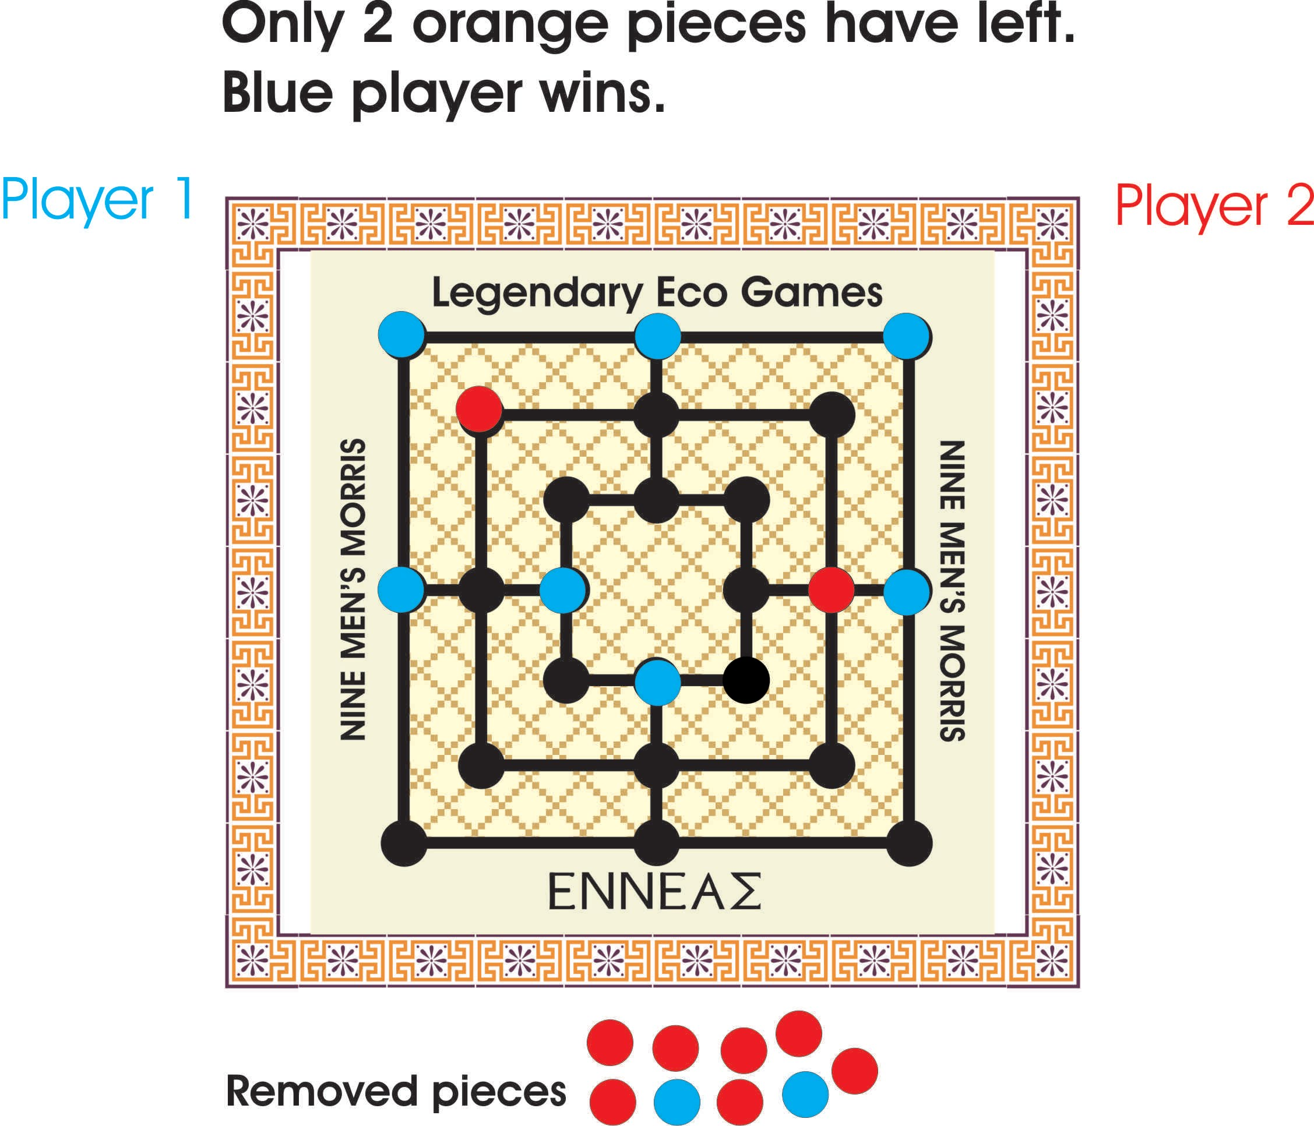
End of the Game.

Slide 11
HISTORY
People have been playing Nine Men’s Morris for thousands of years. The game can be traced back to 1400 B.C.! Ancient Nine Men’s Morris game boards have been found carved into walls of buildings in Egypt, Sri Lanka, Greece and Ireland. It became a widely popular game in Europe during the 14th century. Nine Men‘s Morris even got a mention in William Shakespeare’s “A Midsummer Night’s Dream.”

Slide 12
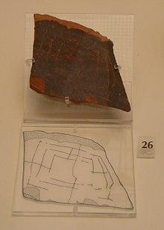
Clay tile fragment from the archeological museum at Mycenae showing what appears to be a Nine Men's Morris board.

Slide 13
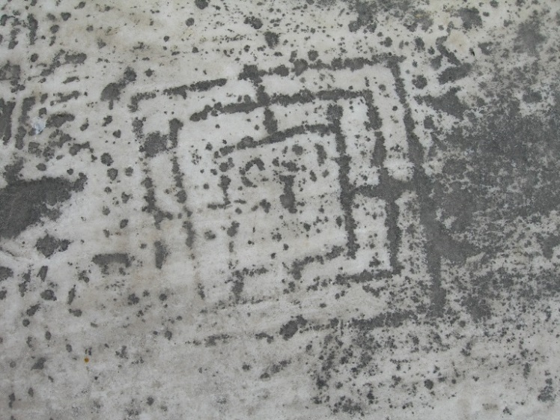
Nine Men’s Morris in Hadrian’s Library, Athens, Greece.

Slide 14
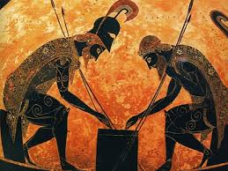
Ancient Greeks playing some board game.

Slide 15
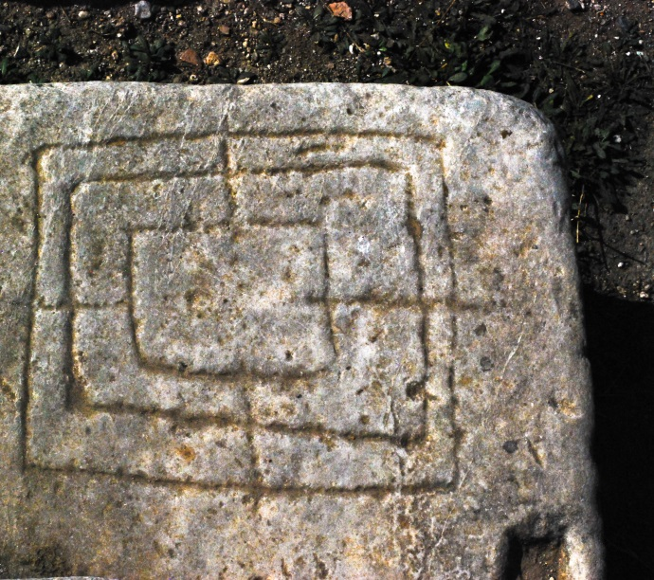
Nine Men's Morris carved into stone in the ruins of Byzantine church, St. John's

Slide 16
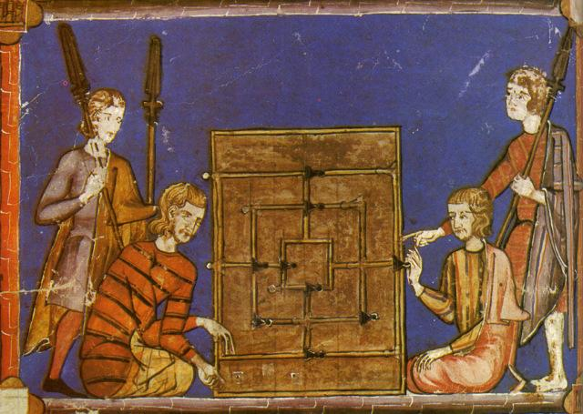
A 13th century illustration of playing Nine Men’s Morris (from Libro de los juegos-Book of games)

Slide 17
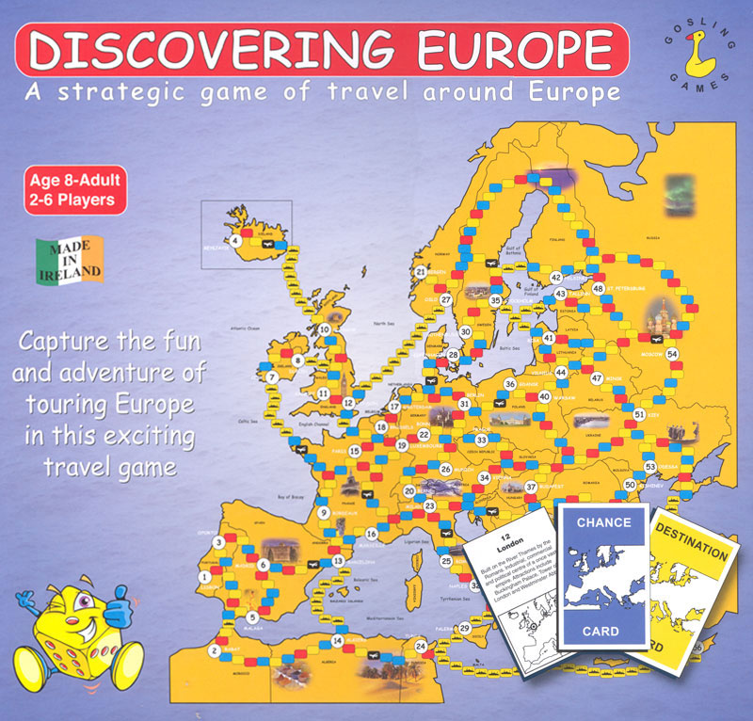
Discovering Europe
Game from Ireland

Slide 18
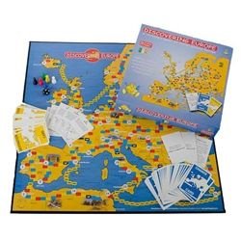
Aim of the Game
To go on a trip around Europe and visit all your destinations before any other player.

Slide 19
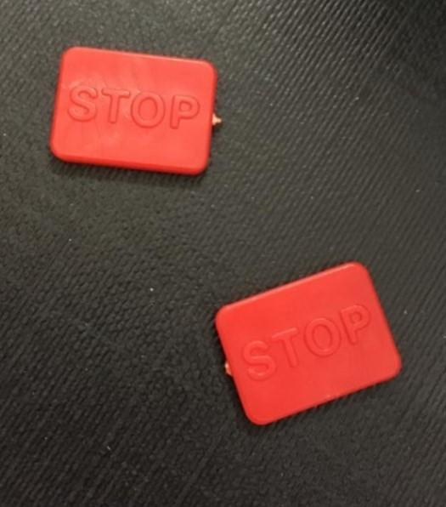
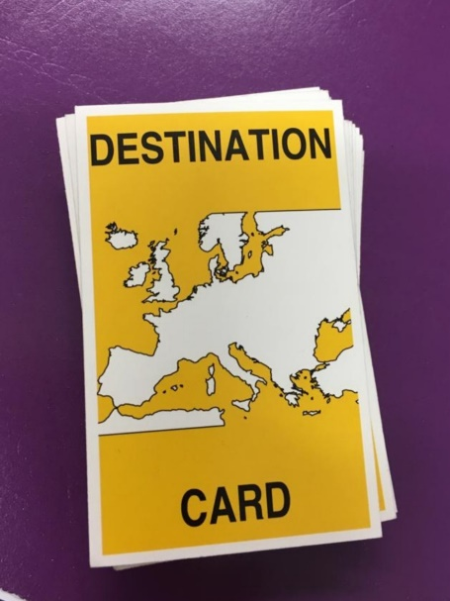
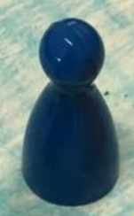
Each player is given:
3 red traffic lights
6 Destination
cards
I travel
token

Slide 20
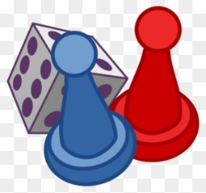

Rules
Hand out 6 destination cards.
Look at your cards and make a plan of your journey.
Decide on your route i.e. where you will start and finish the game.
Place your red traffic lights on the map.
The player who throws the highest number on the dice will start.
Place your travel token on your chosen start point and begin your journey.
When you reach a destination, put that card back on the card pile. When you are on your last card tell the other players .
Most importantly have fun!!

Slide 21

Traffic Lights
Each player will receive 3 red counters.
They will place them on a red box on the map to slow down their opponents.

Slide 22
When to pass a Traffic Light
When you throw a 6 or an 8 on the dice you can pass.
If you roll the dice 3 times without getting a 6 or an 8 you can pass.
If you have a blue chance card the says “ Move any Traffic Light”.

Slide 23
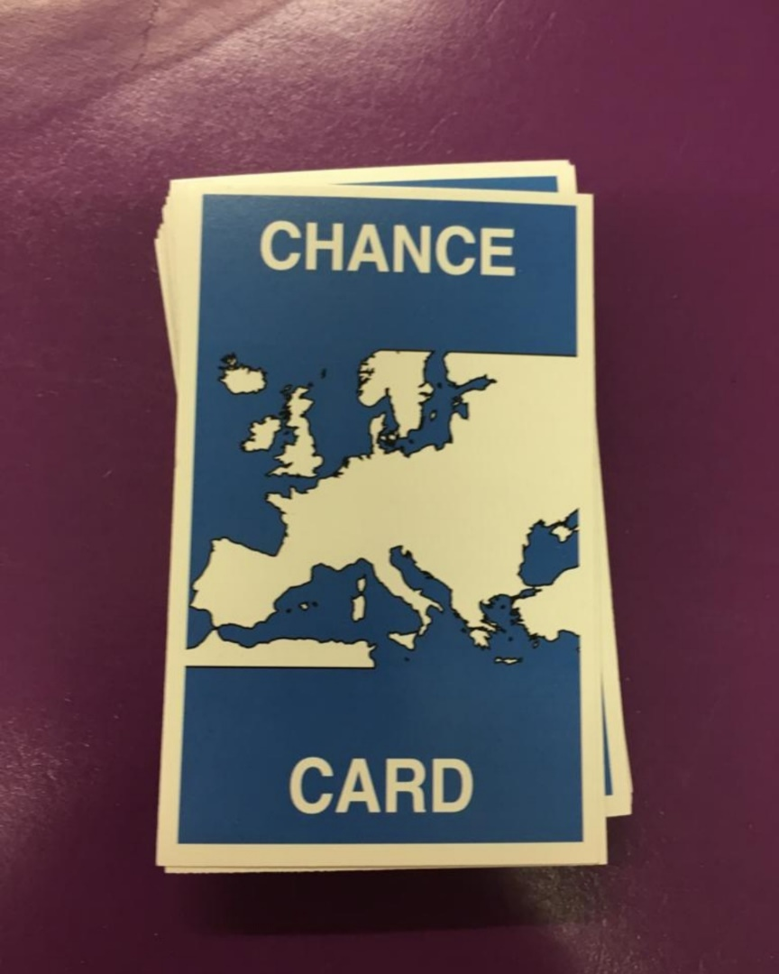
Blue Chance Cards
If you land on a blue box you must pick up a blue chance card.
You must use the card straight away unless it says “Keep this card”.
If you get a “Keep this card”, you can keep it and use it when asked to move to unwanted destinations.

Slide 24
Airline Ticket
If you get an Airline ticket you can keep this card.
If you pass an airport you can use the card to move to another airport.
If another player lands on an airport you can ask them to move also.

Slide 25
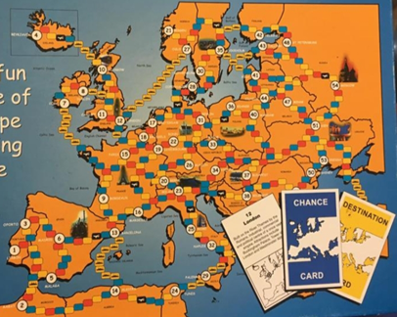

Slide 26

ENJOY
&
HAVE FUN!!

Slide 27
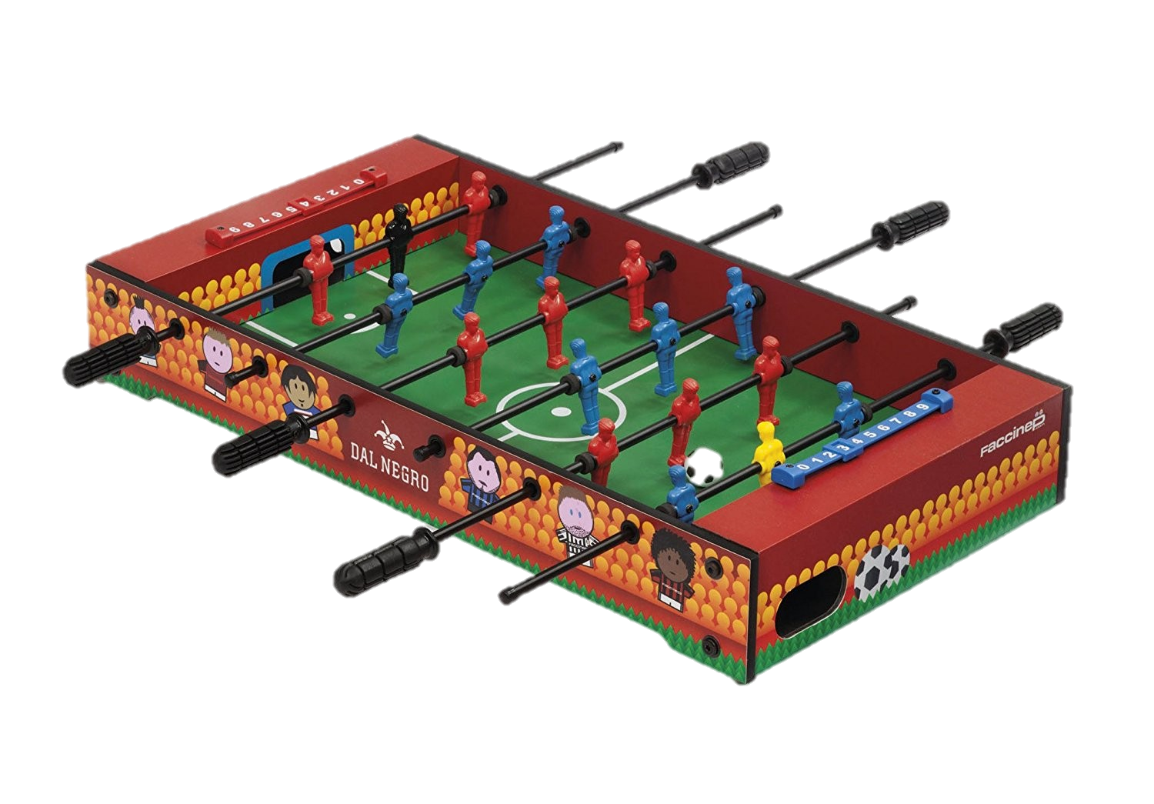
Game from Italy
Football Table

Slide 28
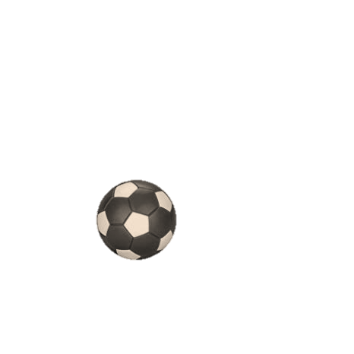
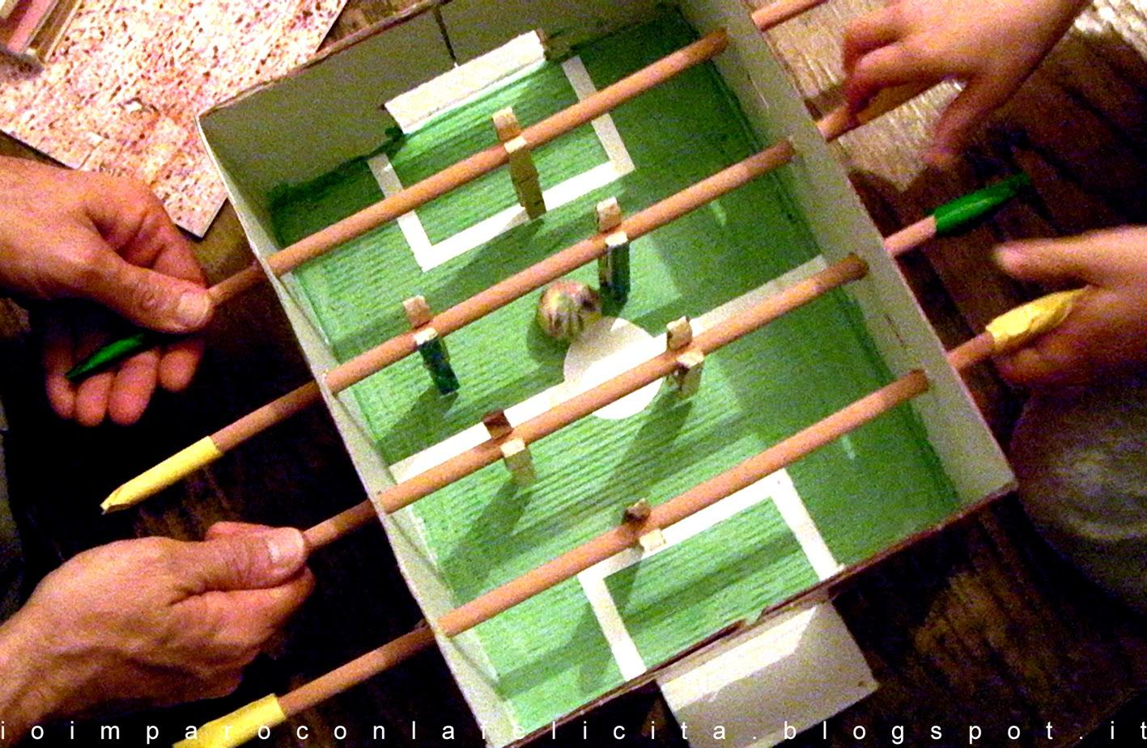
Table football or table soccer, foosball in North America, is a table-top game that is based on football. The aim of the game is to use the control knobs to move the ball into the opponent’s goal. There are no unified rules for playing the game, in the sense that rules vary in different countries and even in cities, and sometimes between different clubs in the same city.

Slide 29
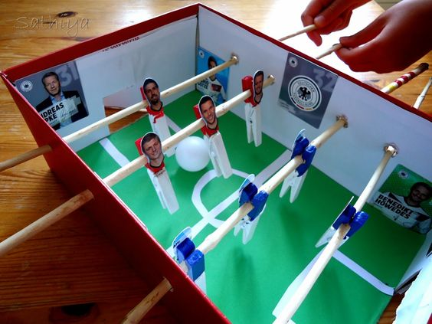
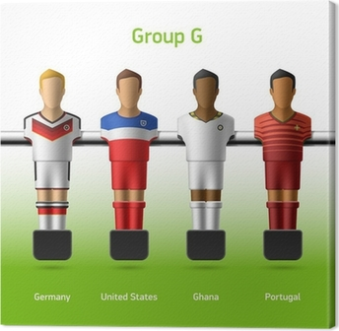
Players
You play either one against one or two against two.

Slide 30
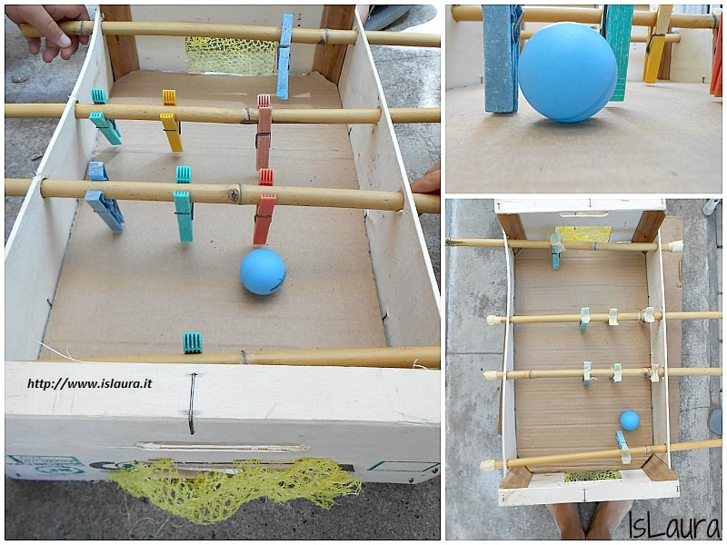
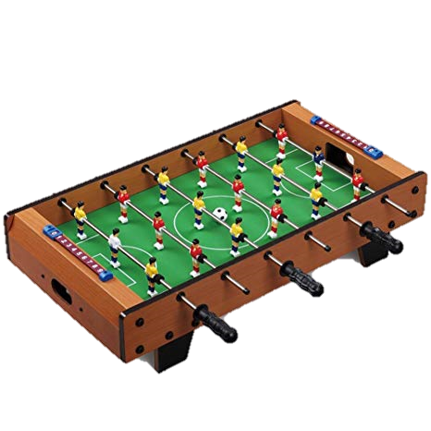
Tools
The foosball table is rectangular in shape; it can be made of wood, plastic or cardboard, on the bottom of which a soccer field is painted with the boundaries of the typical areas of the real game.
On the lateral sides are inserted some rods to which rows of plastic players are fixed, (in the simplest case a goalkeeper and three defenders who will also perform the task of attackers)
A ball is used to play.

Slide 31
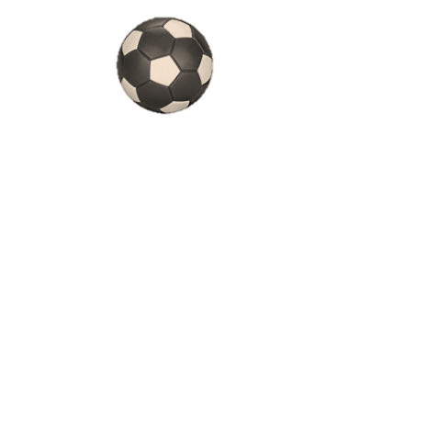

Game Rules
The game begins with the toss of the coin.
The choice of the field is up to the team that wins the draw.
The ball must reach the bottom edge of the field and kick or continue to dribble on the board or between the players of the two teams.
Any violation may be penalized by stopping the game and passing the ball to the opponent.
You can also shoot in the goal, with the throw-in from the center, after the ball touches at least one edge of the field.
When the opponent commits a foul the throw-in starts from the center and the opponent remains in possession of the ball.
If an invalid goal is suffered, the ball starts from the defense. In the event that the ball goes out from the edges or stops in areas of the field disputed by the players and unable to resume it, whoever has the last goal will have the throw-in.
Ball possession is allowed for 10 seconds, including shooting and interception.

Slide 32
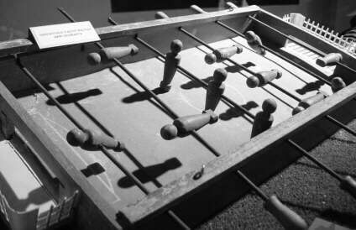
History
Patents for similar table games date back as early as the 1890s in Spain. However, foosball's origins go back to 1921, when Harold Searles Thornton from the United Kingdom patented the game.
He invented the game due to the popularity of football in Europe, which was spreading so rapidly Harold decided to make a game that people could play in their homes. Since Europeans call the real sport football, Harold decided to call his new creation "Foosball".
The French inventor Lucien Rosengart (1880 – 1976) came up with the game of table soccer in the 1930s when he was looking for things to keep his grandchildren entertained during the cold winter months. He called the game “babyfoot” instead of foosball.

Slide 33
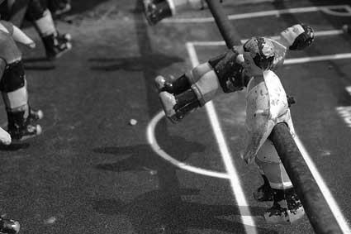
Alejandro Finisterre patented his invention of table football, futbolín, in Barcelona during the Spanish Civil War in 1937. His version of the game is the one used in modern day table football.
The first Italian five-a-side football would have been handcrafted by a craftsman from Poggibonsi.
The game was eventually brought to the United States in the 1950s by Lawrence Patterson, reaching its peak of popularity there in the 1970s, when it could be found in bars and pool halls everywhere throughout the country.
In 2002, the International Table Soccer Federation (ITSF) was established in France with the mission of promoting the game. The ITSF acts as a organizing sports body, regulating international competitions.

Slide 34

ROCK & PLAY
OR
`O` & `X`
Game from Latvia
Madona Secondary School

Slide 35

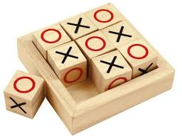
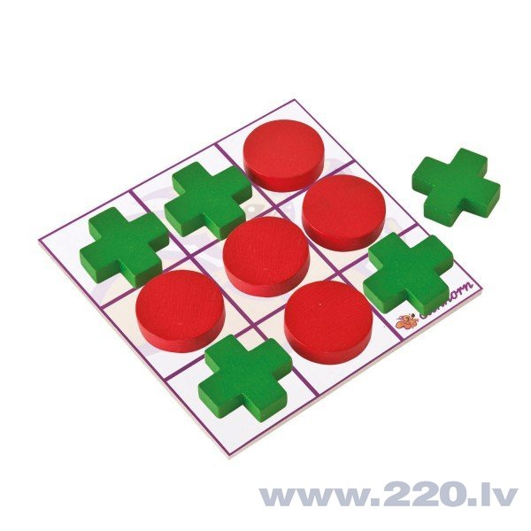
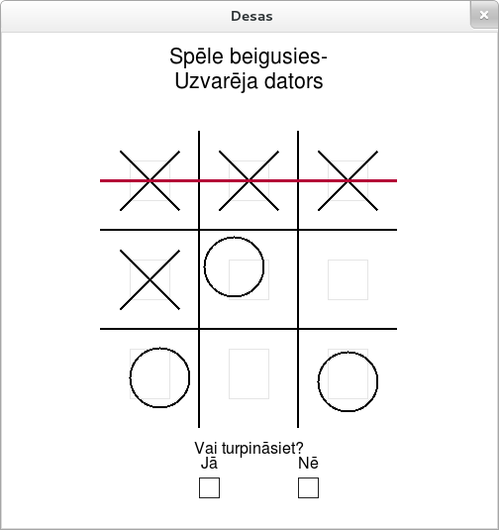
HISTORY OF THE GAME

Slide 36
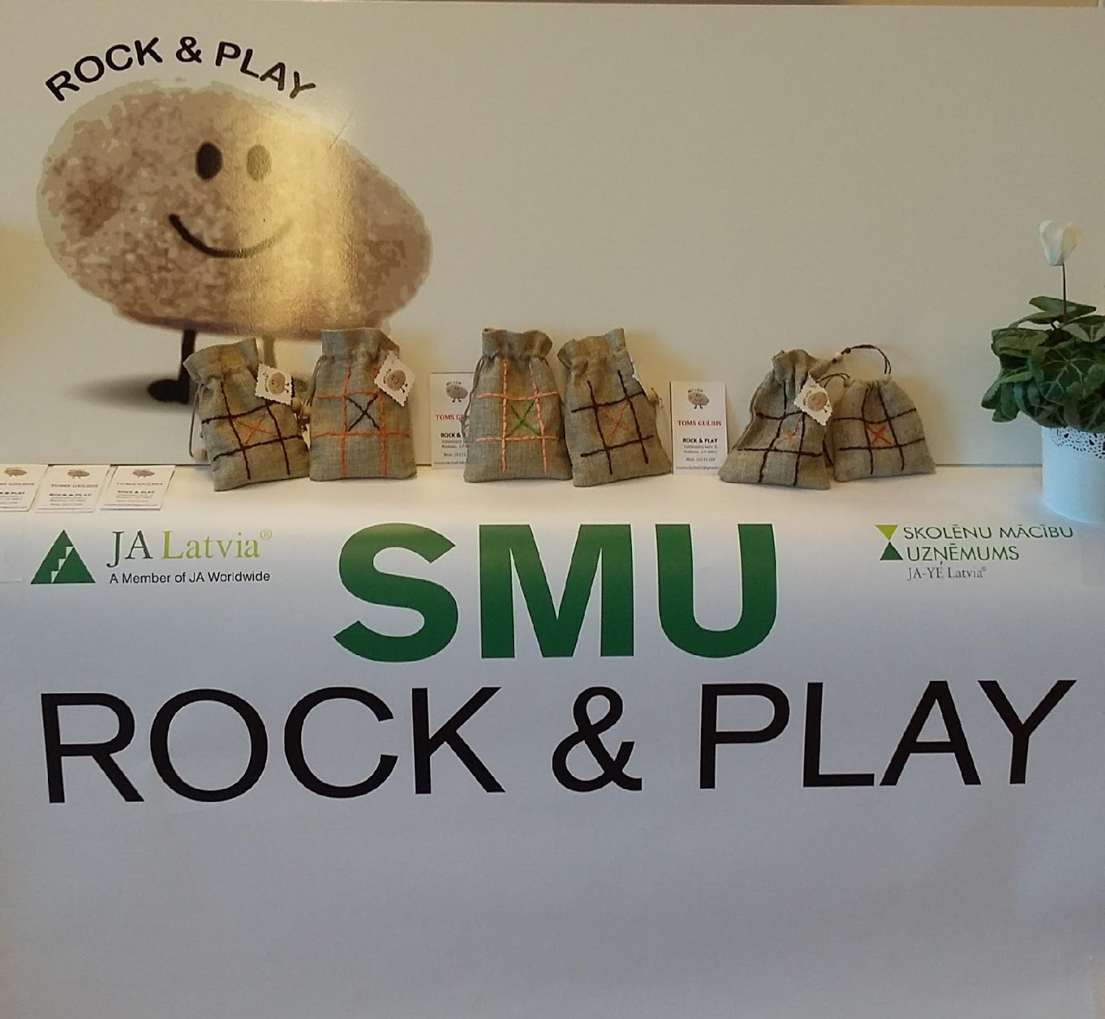
EXCITED FREE TIME ACTIVITY GAME
ROCK & PLAY

Slide 37
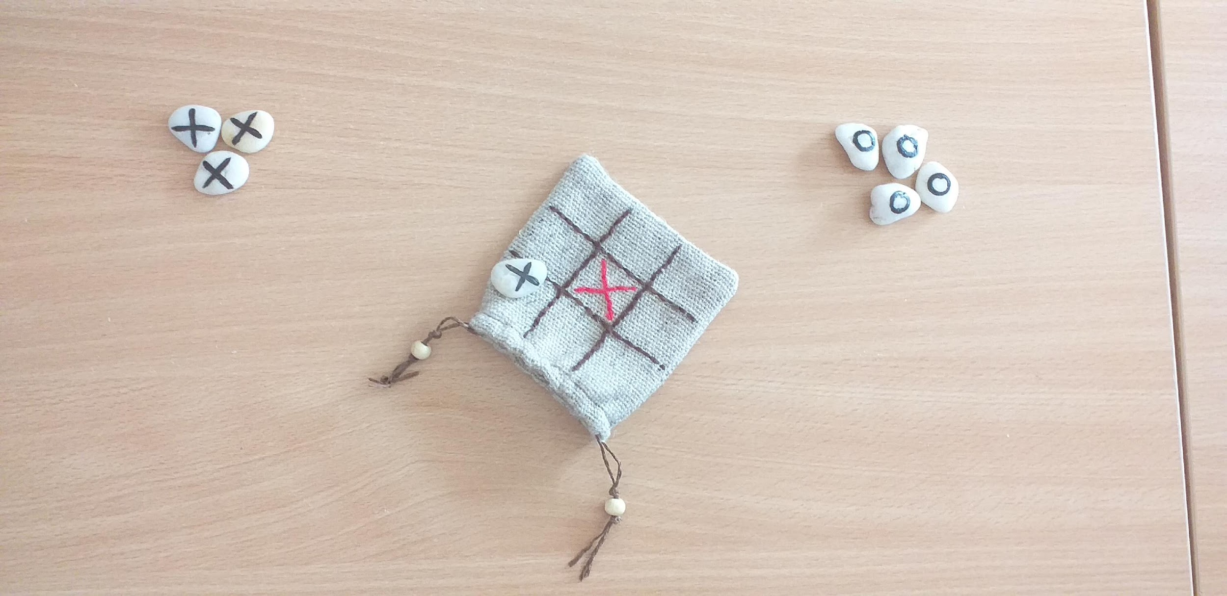
HOW TO PLAY?
The game for 2 players
Choose 4 stones with
the sign `O` or `X`

Slide 38
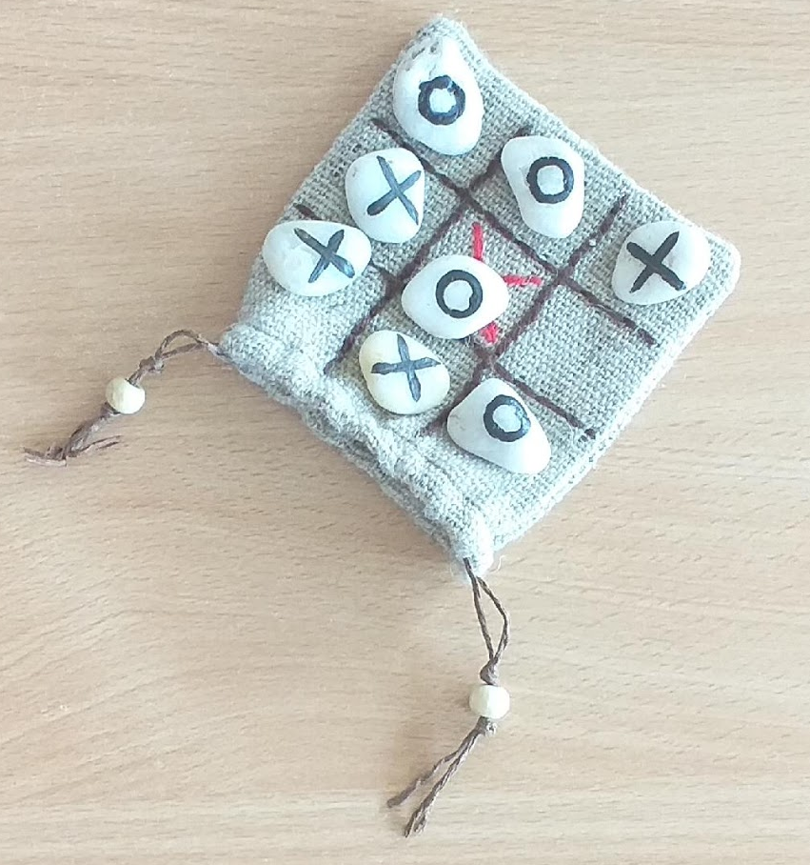
HOW TO PLAY?
Players put the stones in turn
to get the line, column or diagonal
with the same 3 signs

Slide 39
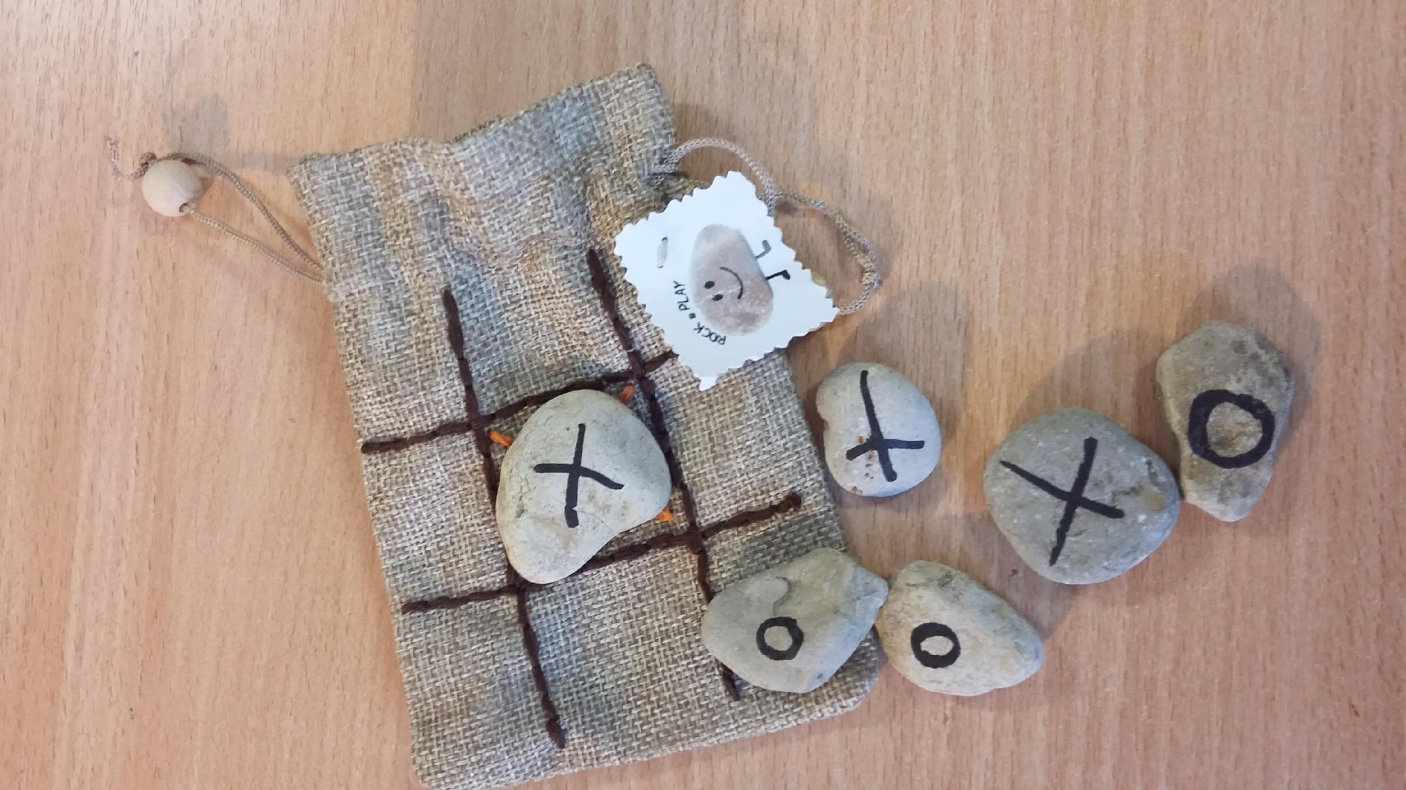
PLAY AND ENJOY!
The game improves
and develops your
attention and reaction

Slide 40
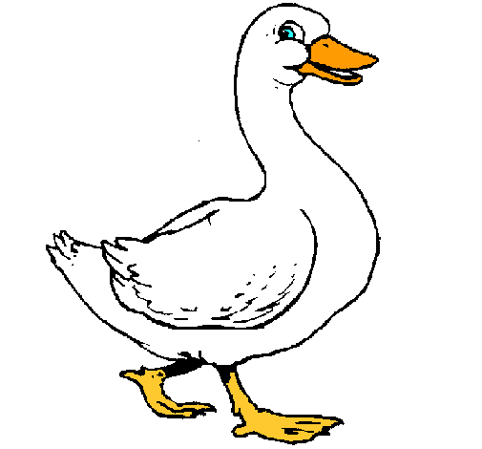
LA OCA
Game from Spain
The Goose

Slide 41
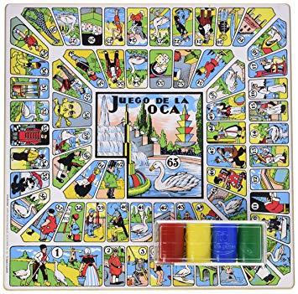
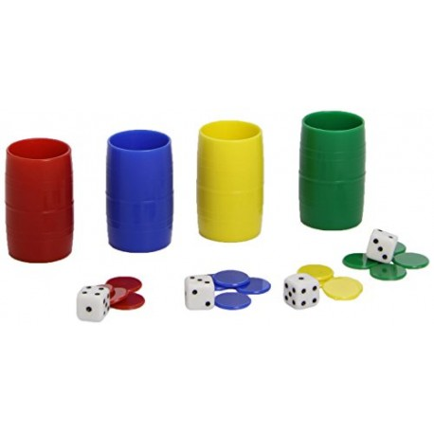

Slide 42
HOW TO PLAY
The Game of the Goose is a board game
2 to 4players can participate with chips of a different color.
The board consists of 63 squares with different drawings.
It looks like a spiral.
There are special boxes with different qualities.

Slide 43
HOW TO PLAY
Each participant rolls a dice that indicates the number of boxes that you have to move forward.
The first one that arrives at box 63 is the winner.
Box 63 can only be reached by exact roll.

Slide 44
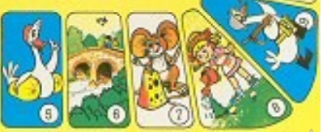
SPECIAL BOXES
Goose [1,5, 9,14, 18, 23, 27, 32, 36, 41, 45, 50, 54, 59, 63]
You have to say "From goose to goose, I move forward because it’s my move“.
In Spanish, the sentence has a rhyme “De oca a oca y tiro porque me toca”.
You advance to the next goose and you throw the dice again.

Slide 45
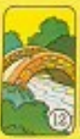

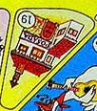
SPECIAL BOXES
Bridge [6,12]
"From bridge to bridge and I throw the dice because the water moves me”.
It moves forward or back to the other bridge and it rolls again.
Dice [26,53] "From dice to dice and I throw the dice because it’s my turn".
It advances or backs up to the other dice and rolls again.
Inn [19] Two turns are lost.

Slide 46




SPECIAL BOXES
Prison [56] 3 turns are lost.
Well [31] It is not possible to throw again until another player advances you or you miss 4 turns.
Labyrinth [42] "From the labyrinth to 30". Go back to box 30.
Death [58] Start again from box

Slide 48
THANK YOU!

Slide 49
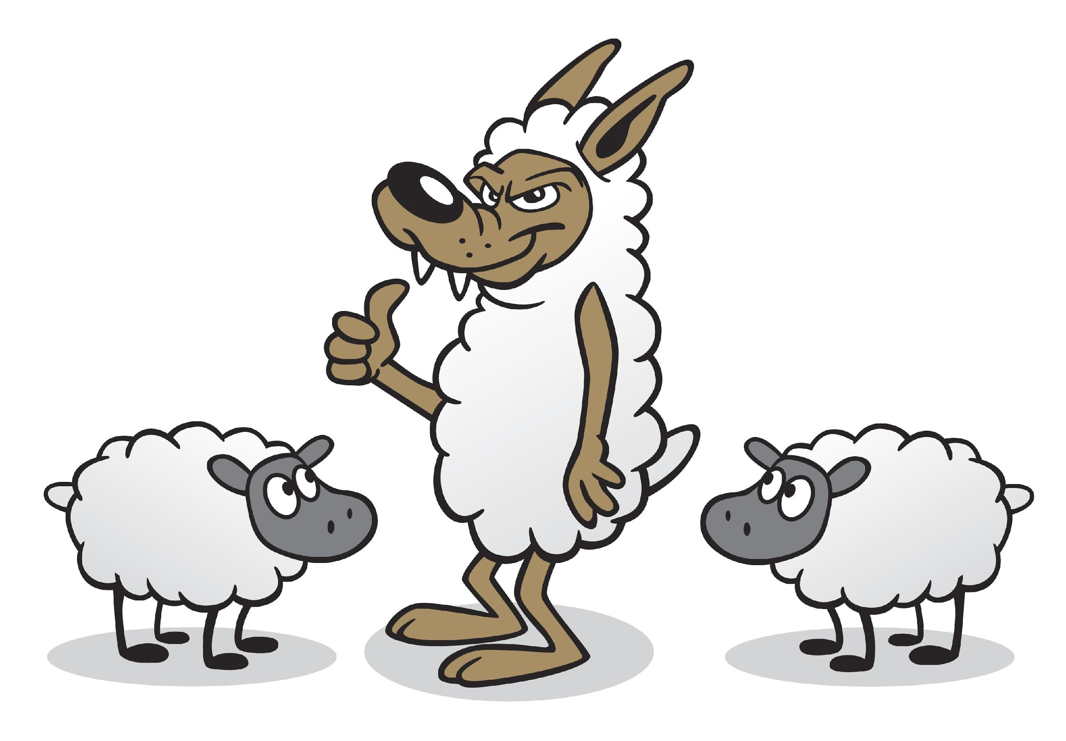
&
Game from Croatia
WOLves
SHEEP

Slide 50
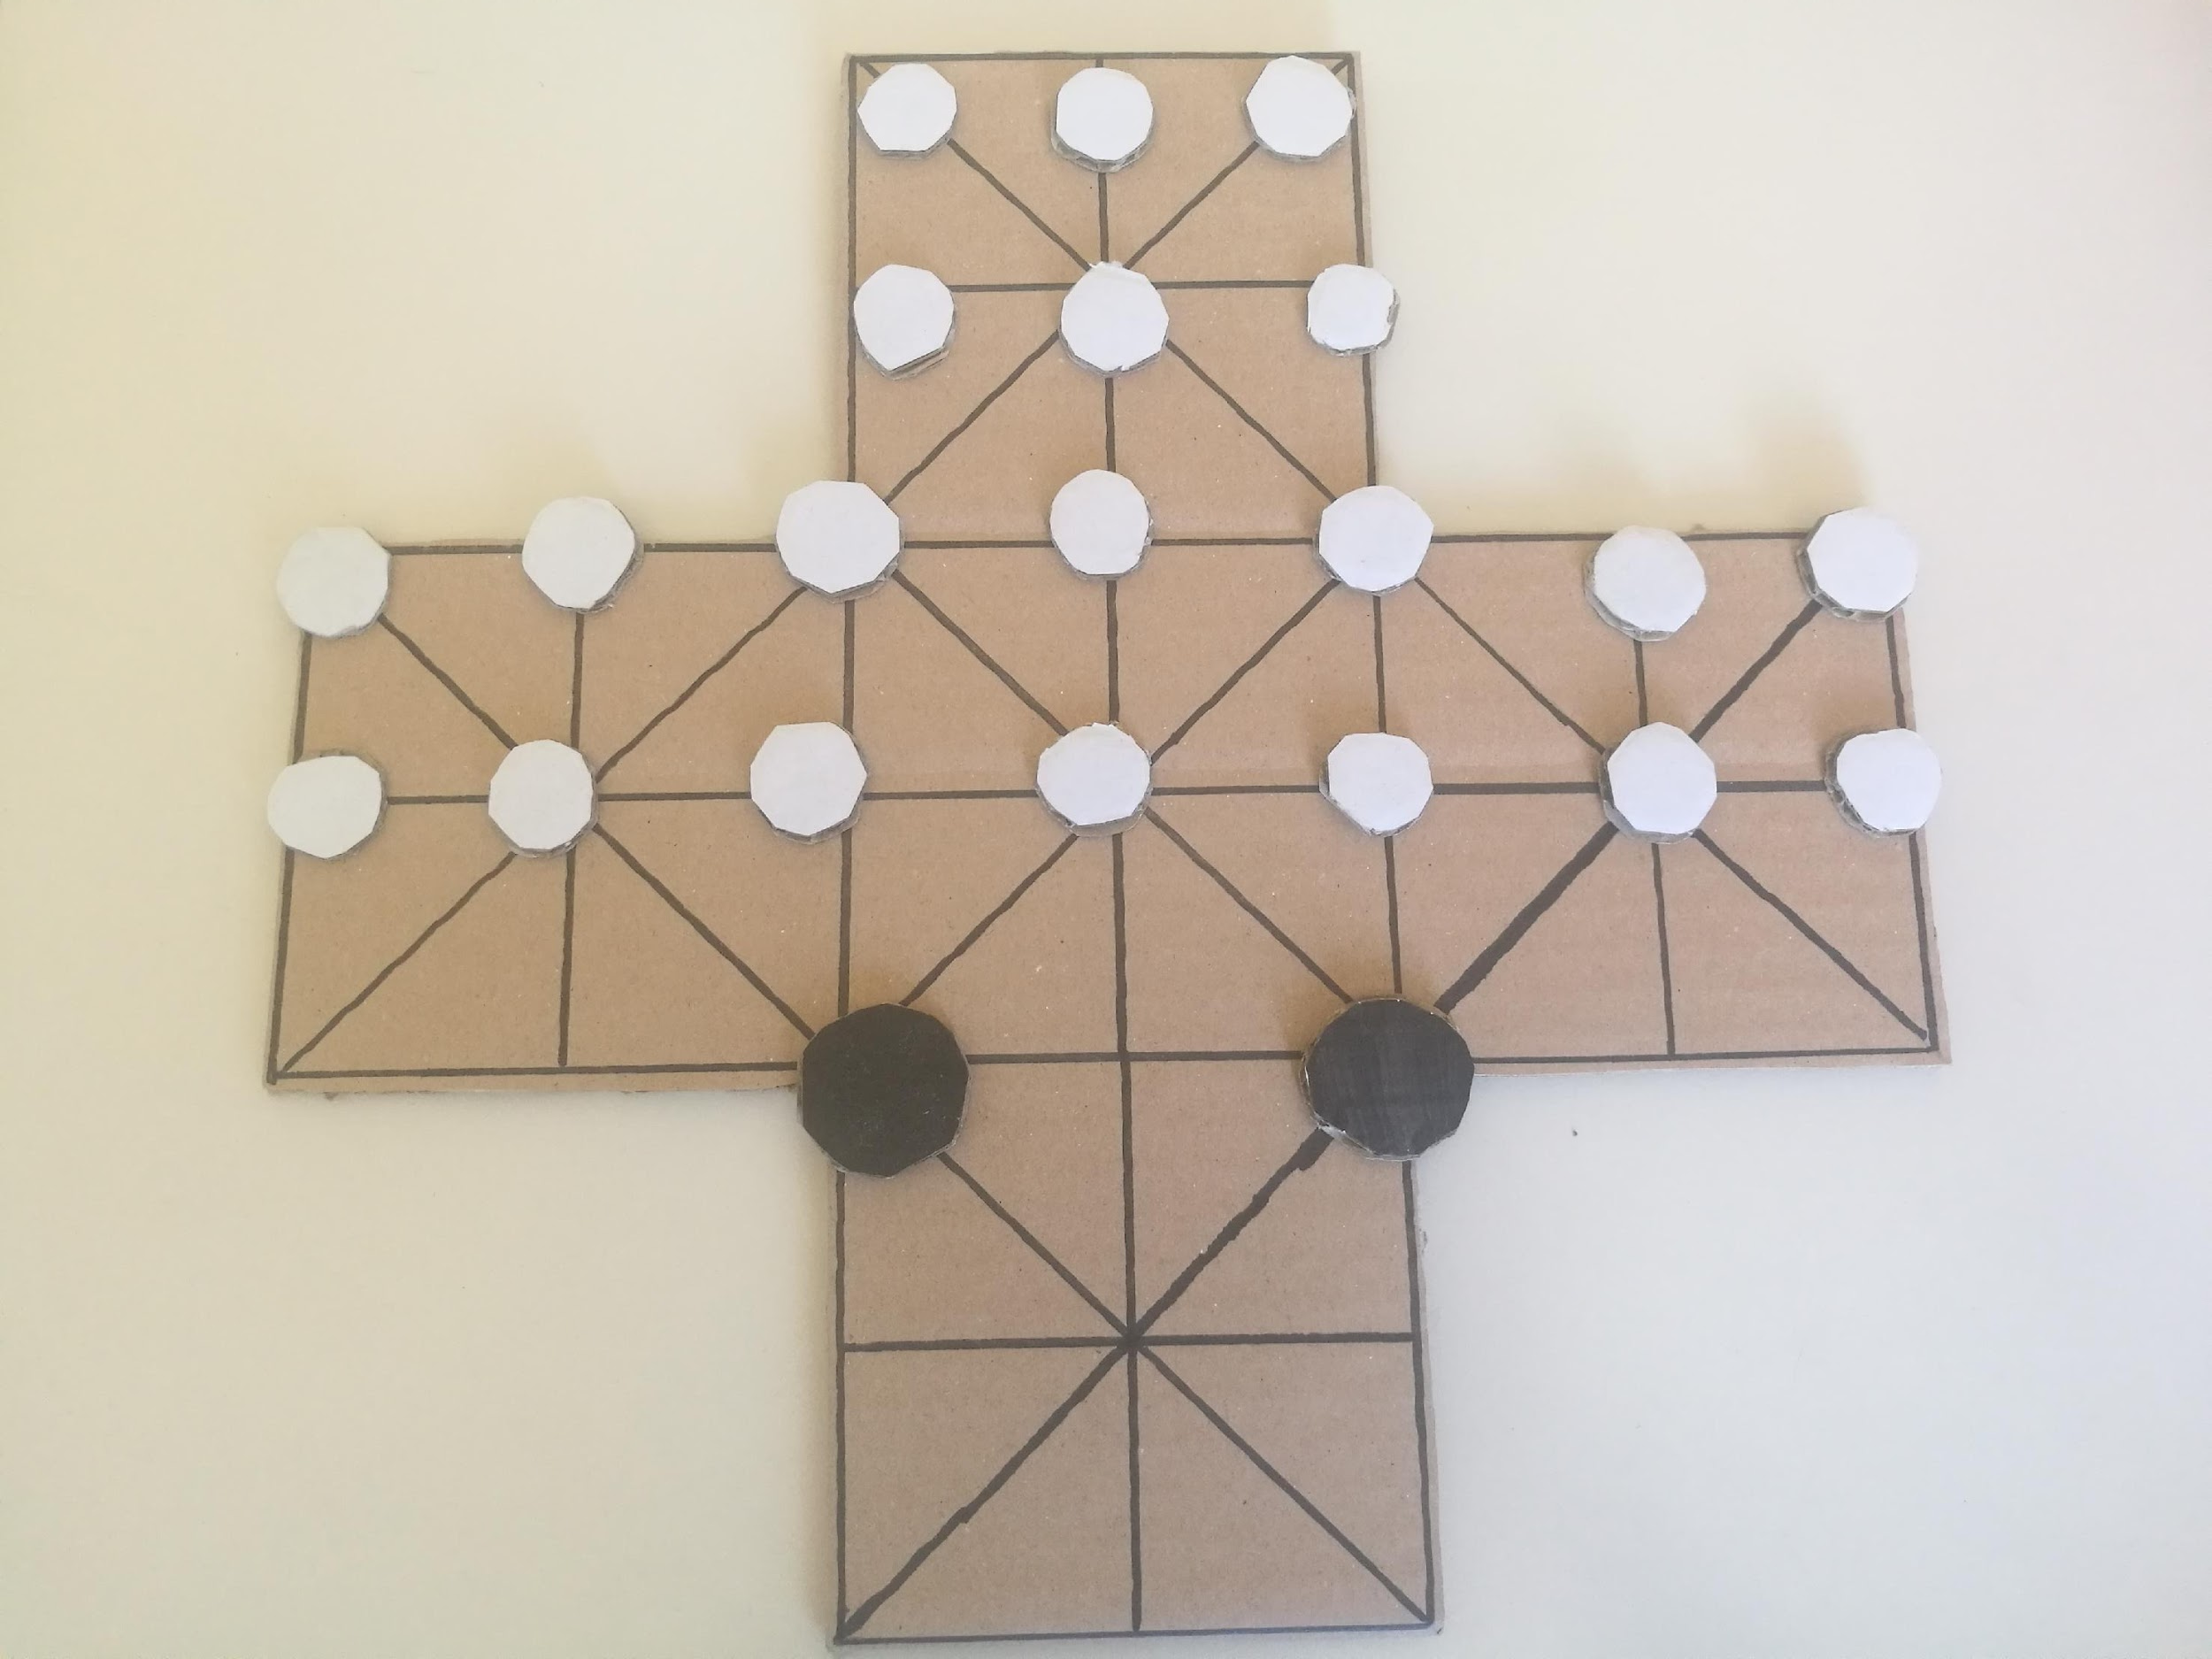
Wolves and sheep, an old game that is slowly falling into oblivion.
Numeral generations played that game on the lake beaches, and all that they needed was a red stone for sketching the playing board, twenty small stones and two larger stones.
Better players were able to spend hours and hours playing with stones and they did not need a mobile phone to have fun, like for example today's generations.

Slide 51
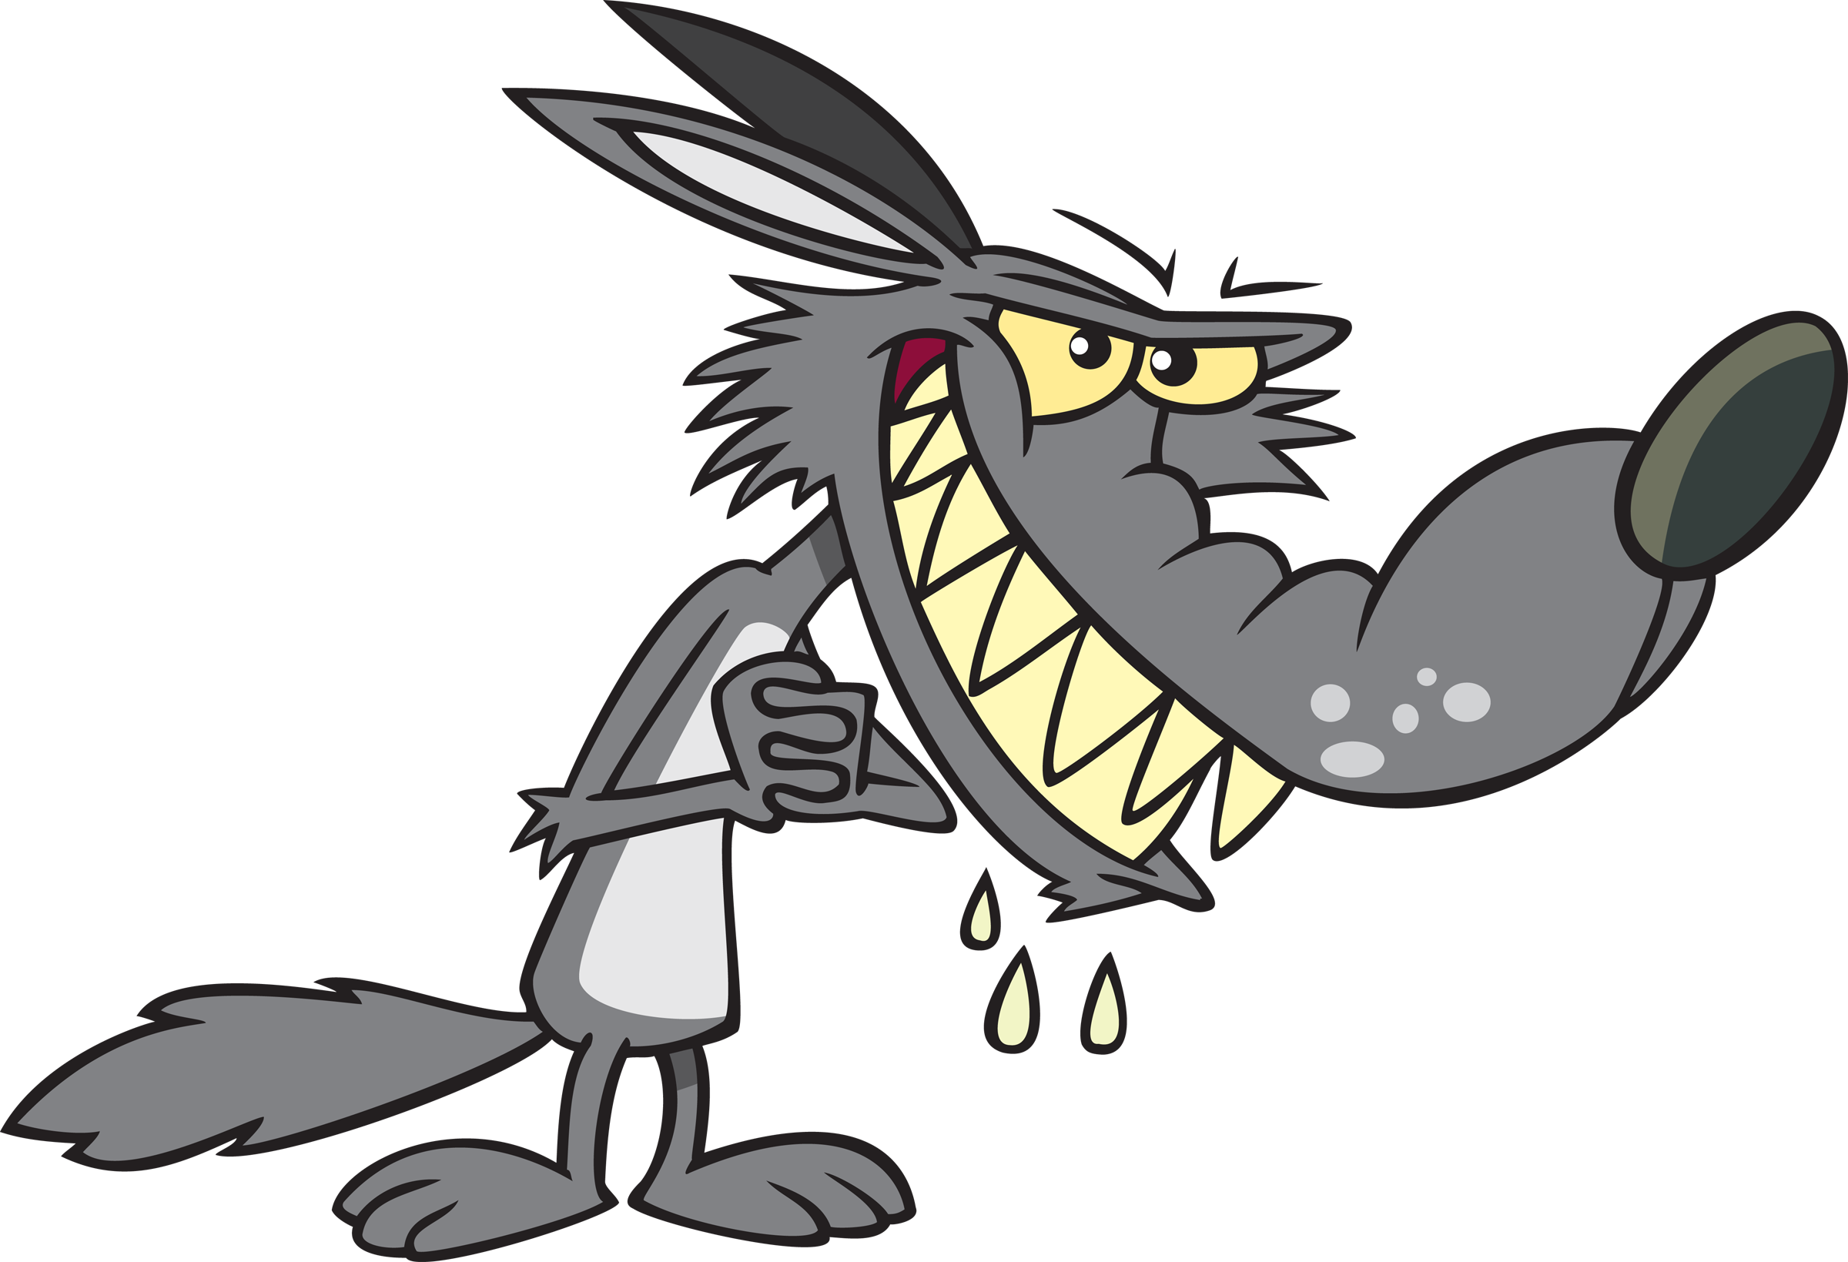
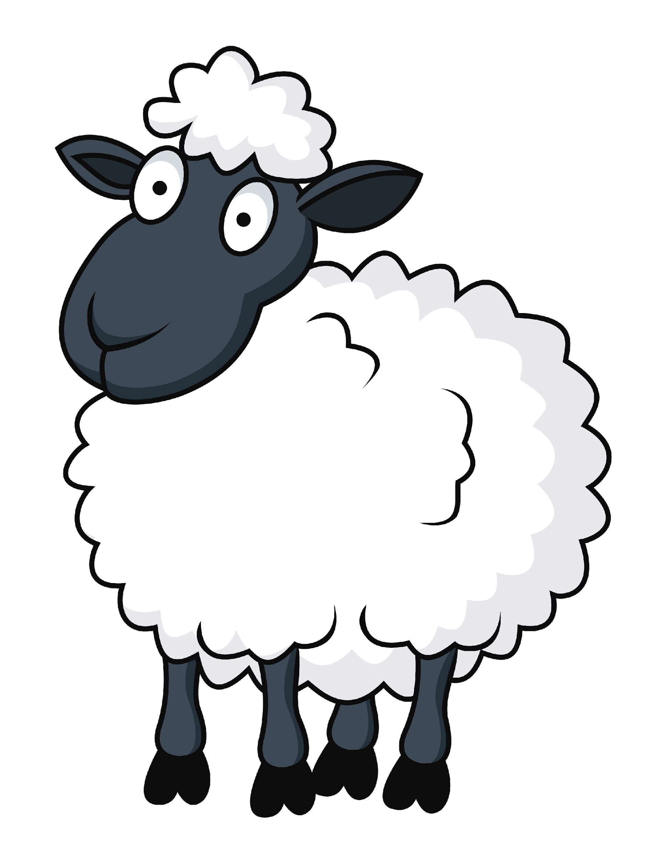
GAME RULES
Players pull figures through intersection that looks like 5 British flags.
The Shepherd has 20 sheep, of which at least 9 have to be driven into a sheepfold that is defended by 2 wolves.
The wolf can eat a sheep if the position behind the sheep an available
A sheep can throw out a wolf out of the game if she finds out that the wolf has missed to eat a sheep. To get back to the game, the other wolf must eat two sheep.

Slide 52
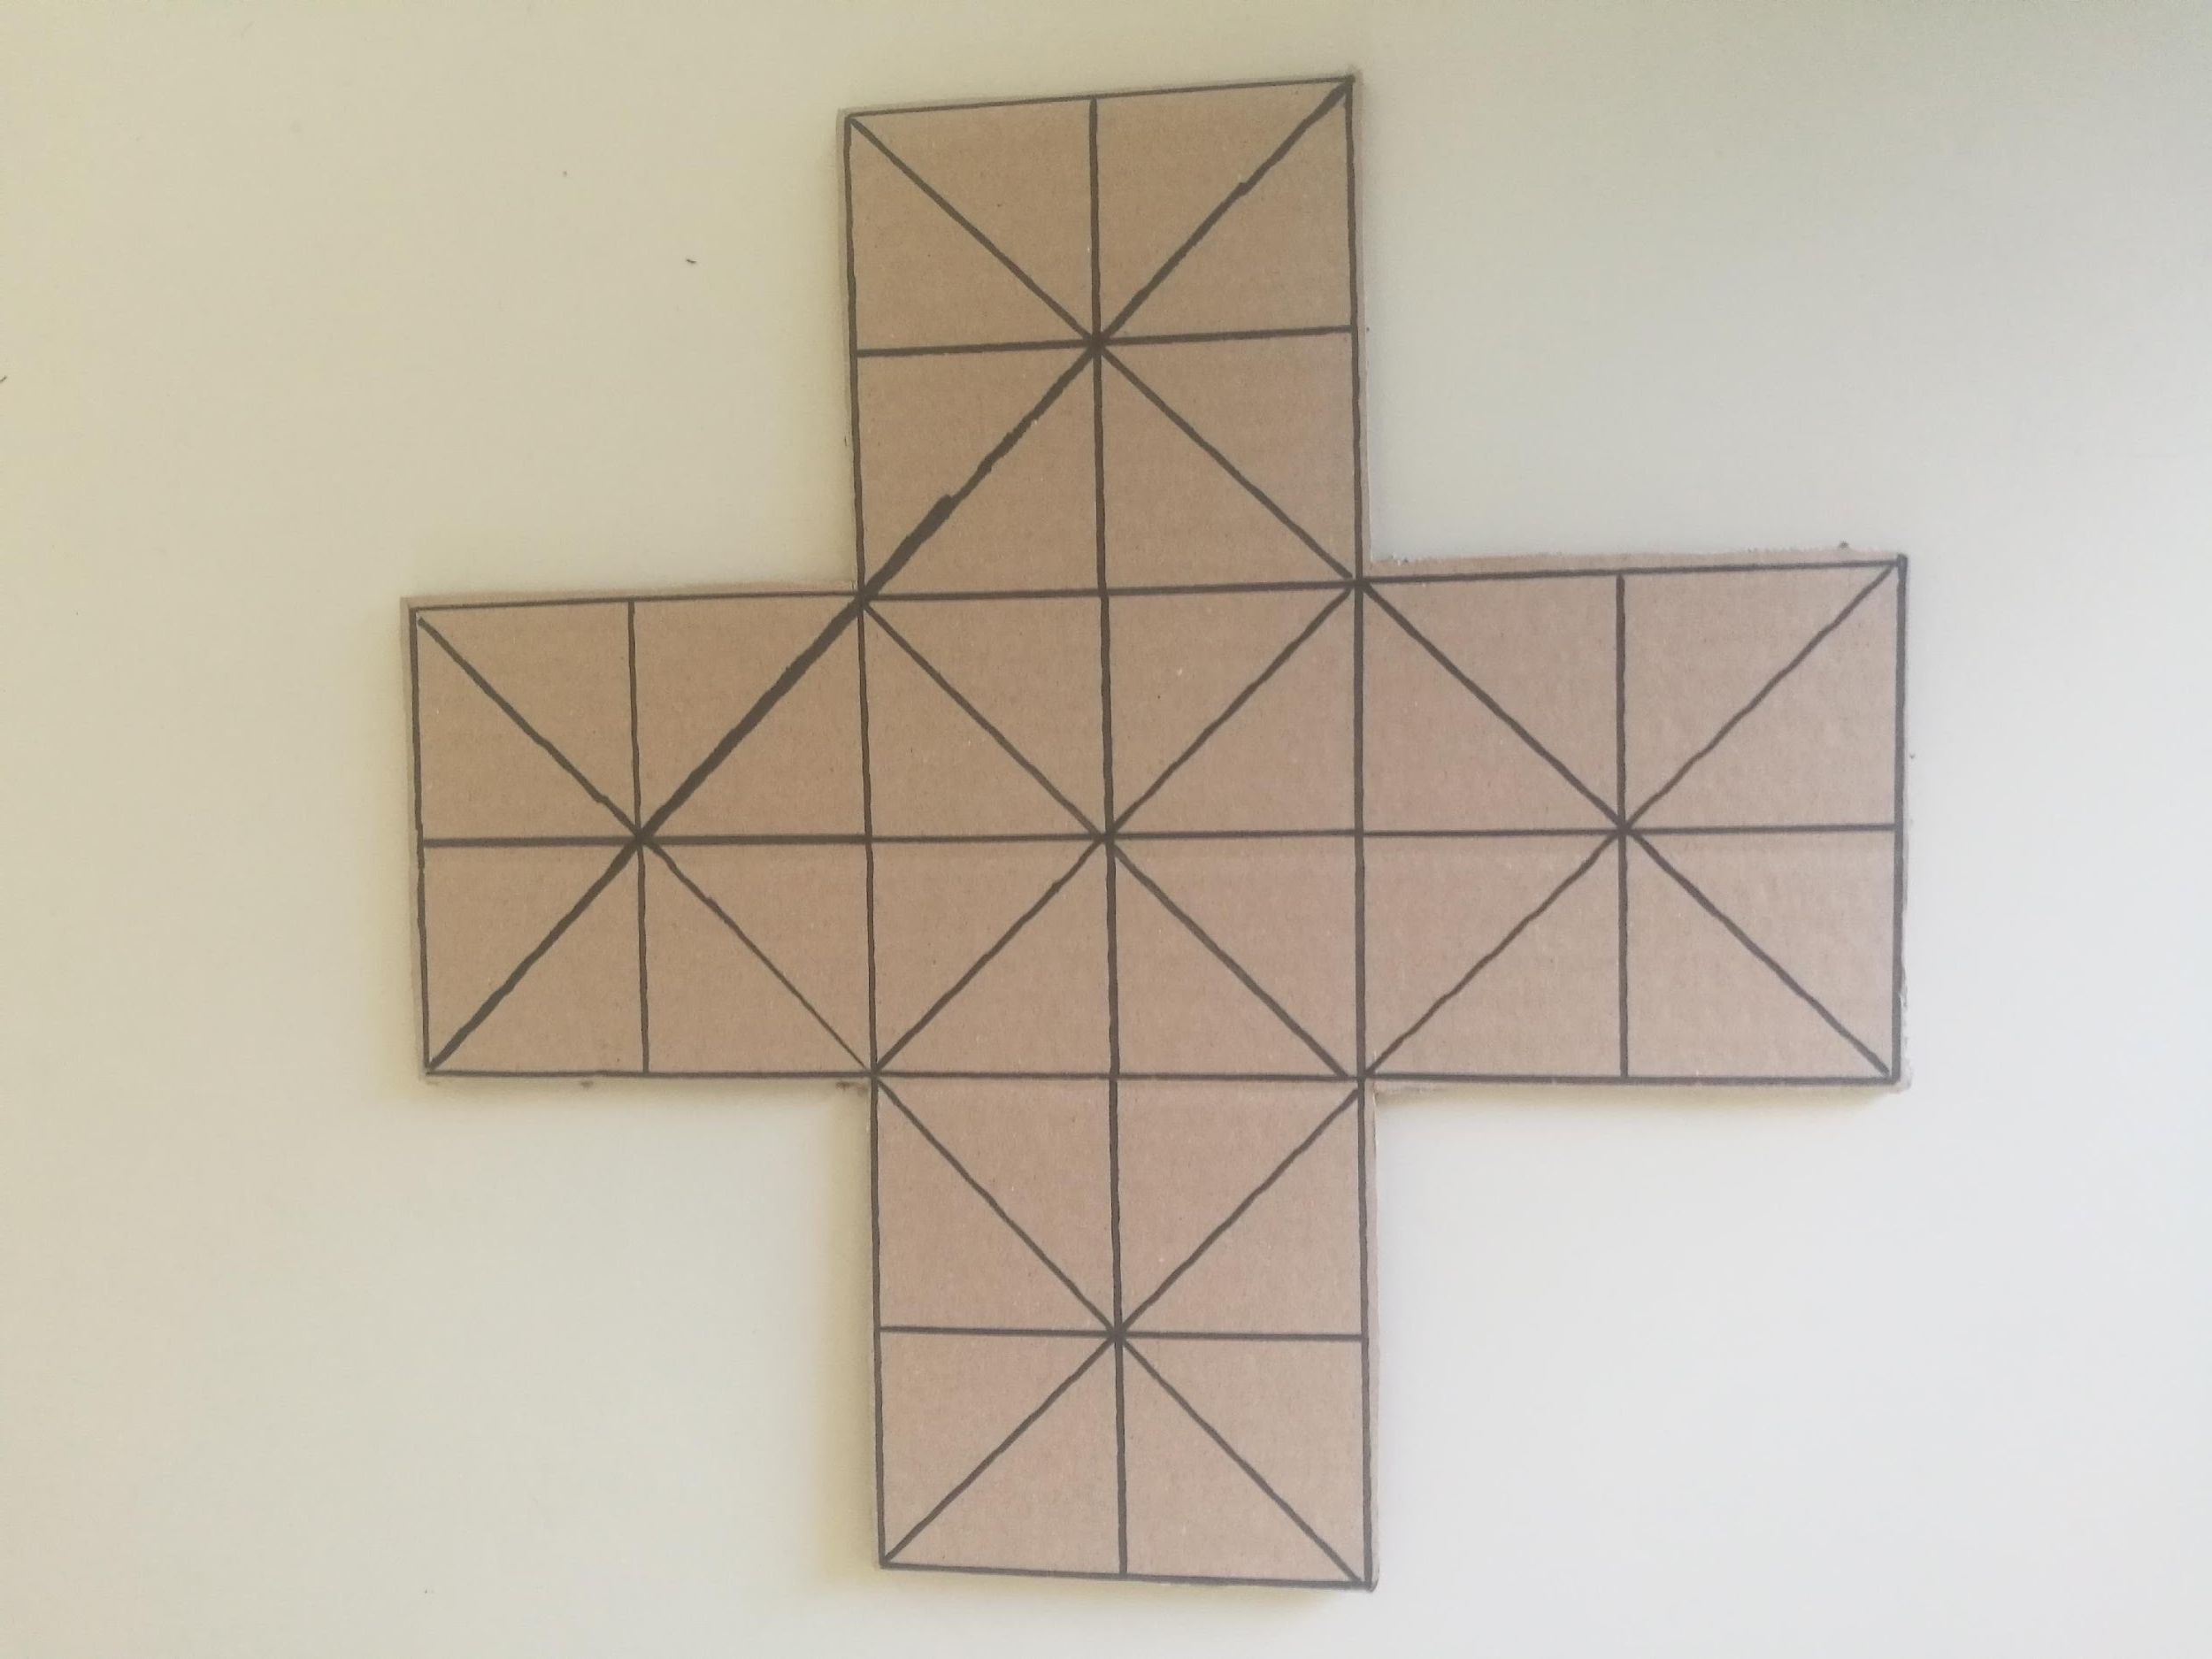
Players pull figures through intersection that looks like 5 British flags.

Slide 53


The Shepherd has 20 sheep, of which at least 9 have to be driven into a sheepfold that is defended by 2 wolves.

Slide 54

The wolf can eat a sheep if the position behind the sheep an available
A sheep can throw out a wolf out of the game if she finds out that the wolf has missed to eat a sheep. To get back to the game, the other wolf must eat two sheep.

Slide 55

The sheep won the game if she enclosed the wolf so that he can't pull the move any more, if all 9 sheep have entered the sheepfold or she threw both wolves out because of the missed dish.
The wolf won if he ate at least 12 sheep.
We tried the game and it is great, but sometimes you can lose your patience.
Come and play with us! We are going to have a great fun!☺

